Slide 1
Day of Education 2023
Soroptimist International of the Americas’
Dream It, Be It
Stephanie Smith
President,
Soroptimist International of the Americas
January 24, 2023
Notes:
Hello, I’m Soroptimist International of the Americas President Stephanie Smith. I’m so excited to be here today to share with you about our Dream It, Be It program and how it increases access to education. SIA just turned 100 years old in 2021, and as an organization, we have been committed to women and girls’ education since the very beginning.

Slide 2
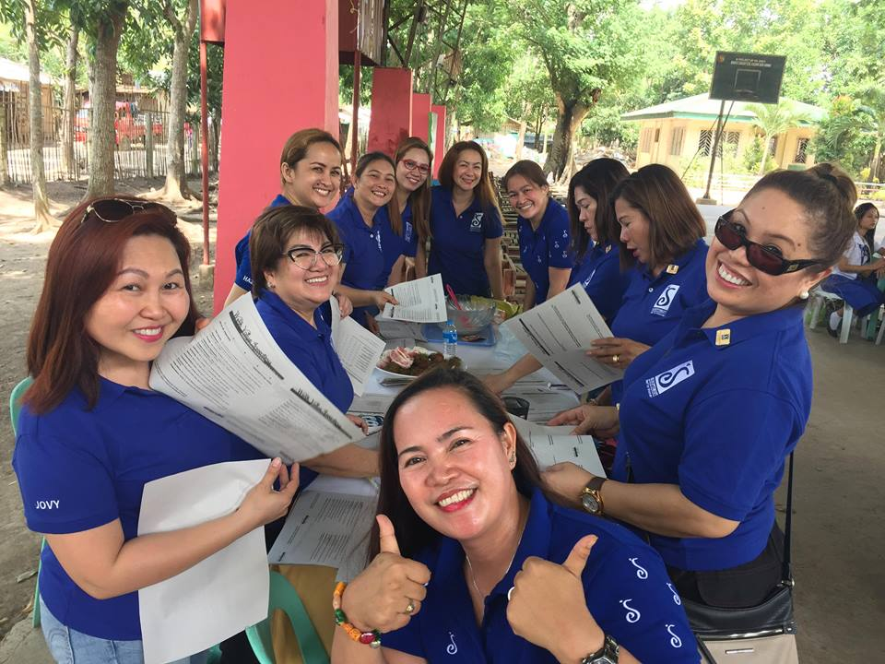
Soroptimist International of the Americas
SIA Club Members from SI/Eagles in the Philippines
SIA’s Dream It, Be It
Notes:
For those who may not be familiar, SIA is a global volunteer organization that provides women and girls with access to the education and training they need to achieve economic empowerment. We operate in many countries and territories throughout North America, South America, and the Pacific Rim.

Slide 3
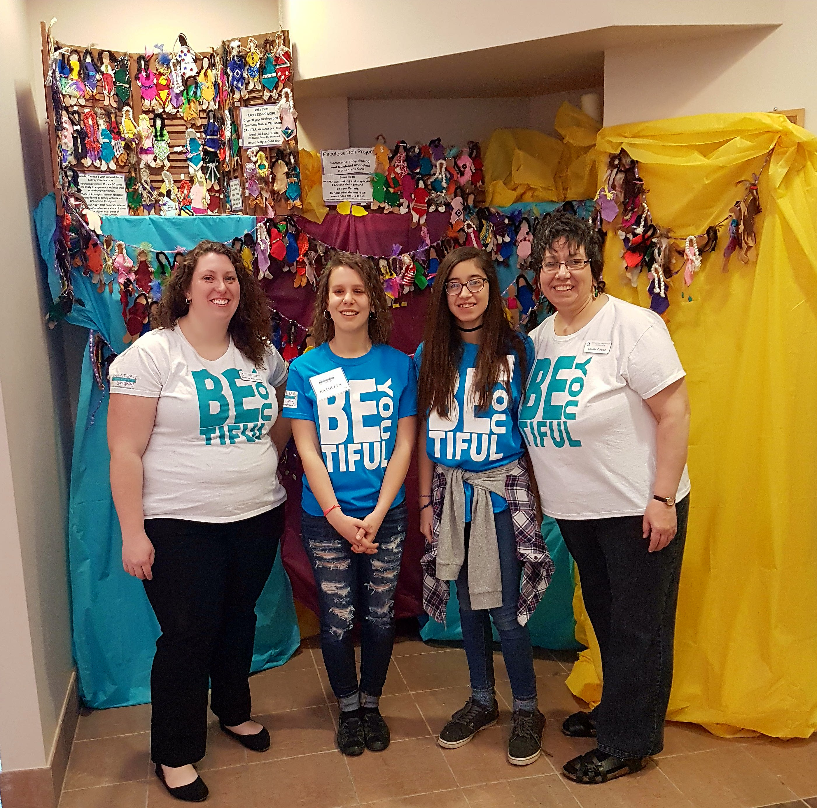
Dream It, Be It
Career opportunities
Setting and achieving goals
Overcoming obstacles to success
SIA Club Members and Dream It, Be It participants from SI/Grand Erie
SIA’s Dream It, Be It
Notes:
SIA developed Dream It, Be It after years of research including surveys, focus groups, and secondary research. This research was crucial to understand what girls needed to secure a successful future and what Soroptimist could provide.
Dream It, Be It provides girls with the tools they need to achieve their education and career goals, empowering them to create their own empowered path.
Through a seven-session curriculum, we provide girls with information about:
Career opportunities
Setting and achieving goals
Overcoming obstacles to success
Moving forward after setbacks or failures

Slide 4
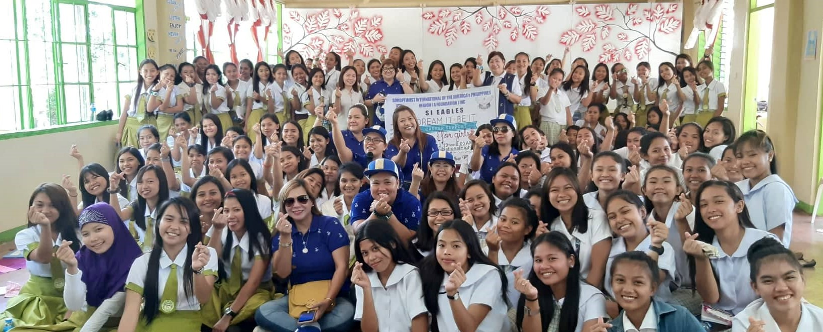
98,000 Girls and Counting
SIA Club Members and Dream It, Be It participants from SI/Eagles
SIA’s Dream It, Be It
Notes:
Although all girls face barriers because of their gender, we prioritize working with girls who have additional obstacles including poverty, unstable home lives, living in foster care, or teen pregnancy and parenting.
Soroptimist clubs work in partnership with girls in small groups or a conference setting to provide them with the information and resources they want and need to be successful.
The time invested in research and development of Dream It, Be It ensured a successful launch the implementation of a program grounded in research. In the past year alone, more than 11,000 girls participated in a Dream It, Be It program in 14 countries around the world. This brings the cumulative total to more than 98,000 girls who have received support, encouragement, and guidance from women in their community since the program launched.

Slide 5
Our Impact
88% of participants feel more confident about their future success
88% created achievable goals for their future
87% have new tools to overcome obstacles to their success
SIA’s Dream It, Be It
Notes:
Dream It, Be It has also had impressive outcomes for our participants.
88% feel more confident about their future success
88% created achievable goals for their future
87% have new tools to overcome obstacles to their success
These outcomes speak to the impact that clubs are having on girls and their futures in their local community. Our strong outcomes also motivate us to serve more girls every year through this program, as our research has found that 10 million girls living in the countries and territories where we operate could benefit from Dream It, Be It.

Slide 6
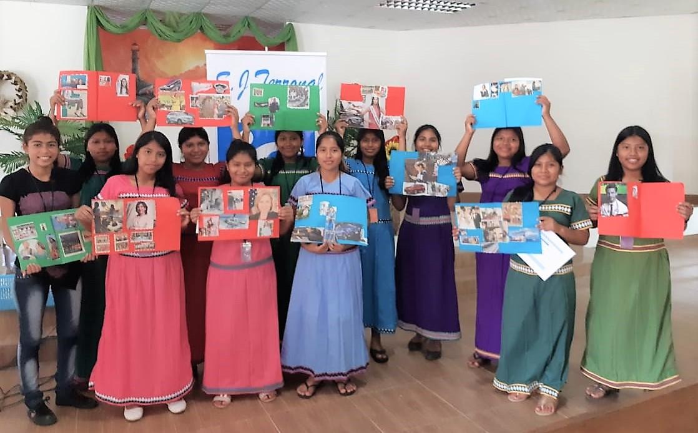
Overcoming Obstacles
Build confidence, knowledge, and skills
Dream It, Be It participants from SI/Terronal
SIA’s Dream It, Be It
Notes:
We encourage our clubs to focus their impact on the girls who need it the most—who are facing additional barriers besides their gender. Dream It, Be It was developed to serve girls facing these kinds of challenges, and helps them to build their confidence, knowledge, and skills to handle their futures. The flexible nature of the Dream It, Be It curriculum also allows clubs to adapt the curriculum to serve girls in different contexts, making it even better suited to meet girls where they are.

Slide 7
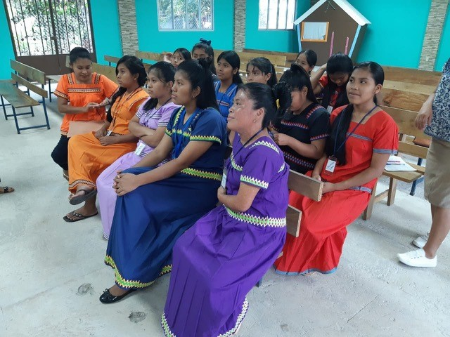
SI/Terronal of Panama
Highlights:
Teaching practical skills
Continued connection with past participants
Dream It, Be It participants from SI/Terronal
SIA’s Dream It, Be It
Notes:
In many countries around the world, indigenous girls are navigating additional obstacles along with the experience of gender-based discrimination. Challenges include lack of access to education, healthcare, and ancestral lands, as well as facing disproportionality high rates of poverty and violence due to discrimination.
Soroptimist International of Terronal in Panama has worked with Ngabe (pronounced: en-gah-bay) indigenous community for the last few years through the Dream It, Be It program. Many of the girls are experiencing extreme poverty and are often unable to attend school due to the remoteness of their community.
In addition to the seven sessions of the curriculum, SI/Terronal showed girls how to craft, sew, and sell hair accessories for the girls to generate income. One former participant from the program is a great example for how Dream It, Be It can inspire girls to tap into their inherent skills and values to in their careers and to help their community: Edorca is a past Dream It, Be It participant from 2018 who was instrumental in supporting more recent workshops and encouraging new participants. Edorca went on to receive to Soroptimist Live Your Dream Award and with her cash award, she bought herself fabric and a sewing machine so that she could engage in entrepreneurship to better support her education. She then taught other girls to sew dresses, and now the girls also make and sell dresses, providing access to their own income.
These inspiring young women work to educate themselves to improve the quality of life for themselves and their families, and to better their community. Dream It, Be It gives them the tools they need to do that.

Slide 8
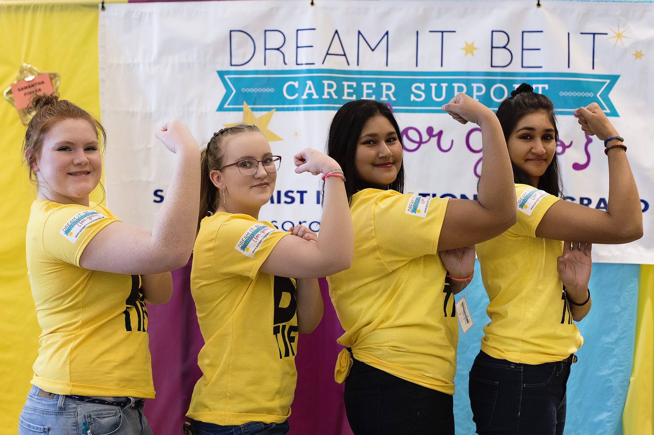
2031: Big Goal
Invest in the Dreams of Half a Million Women and Girls through Access to Education
Dream It, Be It participants from SI/Grand Erie
SIA’s Dream It, Be It
Notes:
Clubs throughout SIA use the transformative power of Dream It, Be It to positively impact girls facing obstacles in their community and help build their skills so that they can achieve their education and career goals. Crucial to their success is relationships: relationships with the girls as mentors, and relationships with their local communities as partners in helping girls thrive. With our Big Goal to invest in the dreams of half a million women and girls through access to education by 2031, we can’t wait to see how our clubs continue to innovate and adapt.

