Slide 1
SOROPTIMIST INTERNATIONAL 2021-2023 Presidents Appeal
September 2021

Slide 2
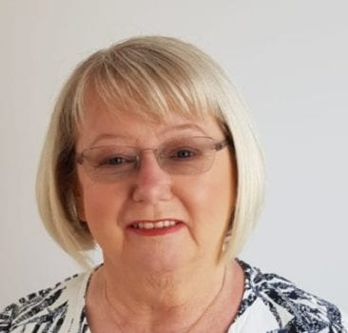
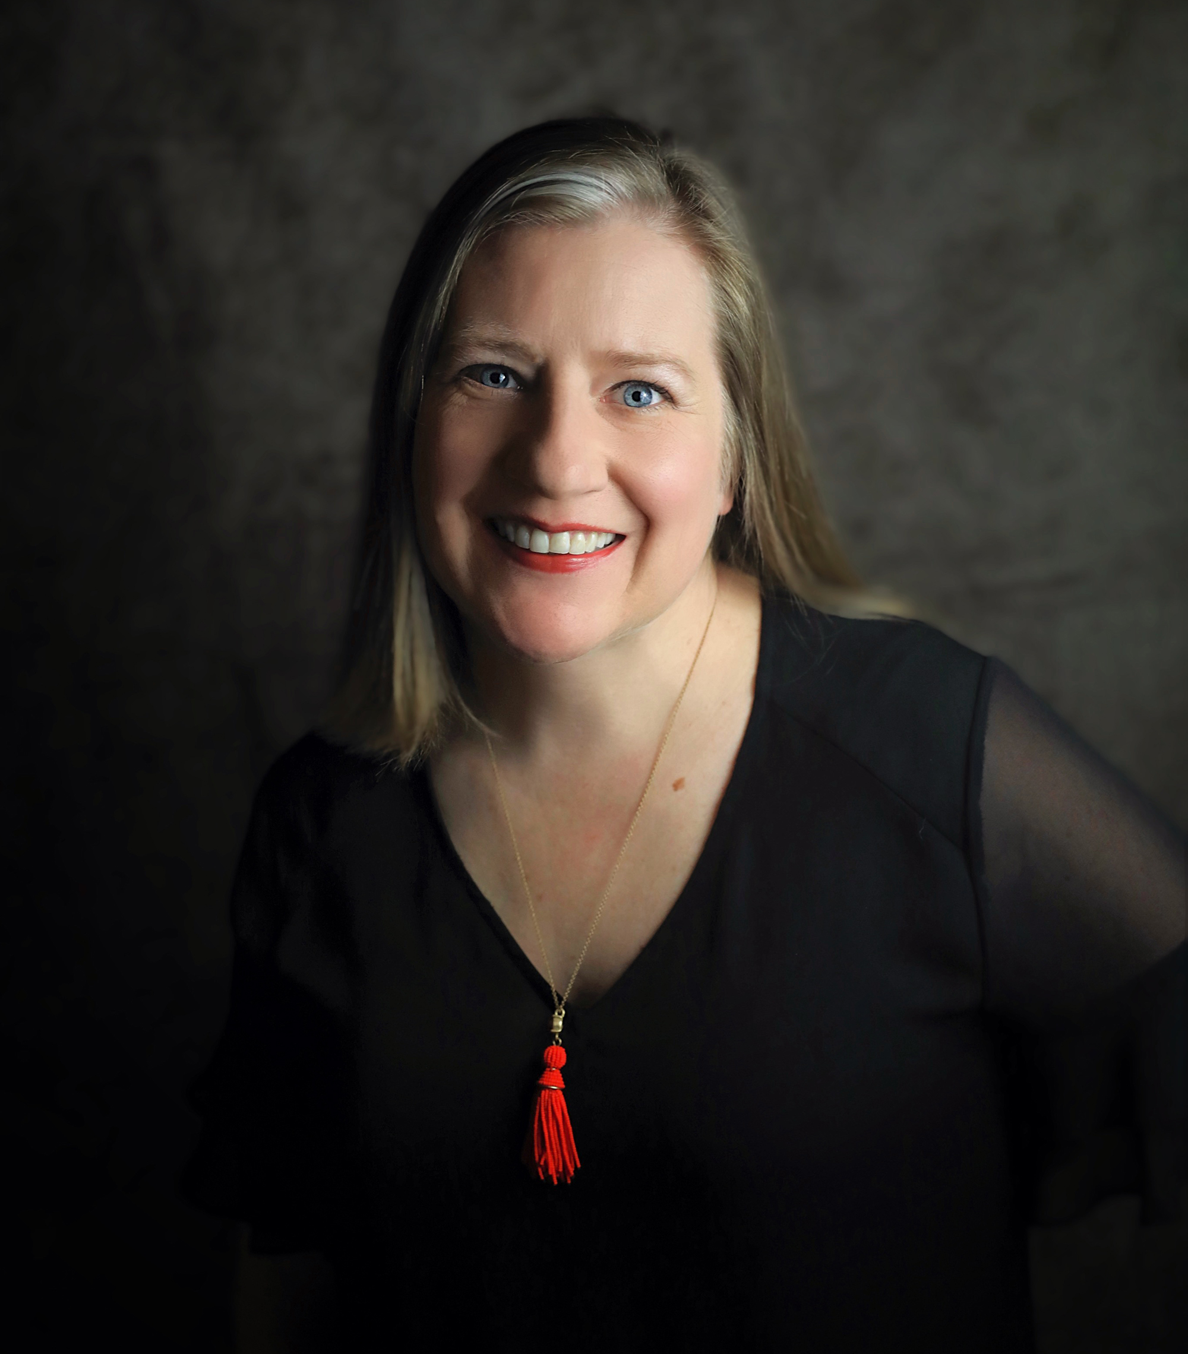
SI PRESIDENT’S APPEAL 2021-23
Maureen Maguire
SI President Elect 2022 - 2023

Slide 3
SI PRESIDENT’S APPEAL 2021-23
Lee Ann Schwope Cochran
SI President’s Appeal Coordinator

Slide 4
BARRIERS TO GENDER EQUALITY
Poverty and Culture
Caring Responsibilities
Gender-based Violence
Forced Marriage and FGM
Child Marriage and Teenage Pregnancies
Necessity to Work
Participation in Leadership and Decision-making
Lack of Schools, Infrastructure, and Unsafe Environments
Limitations to Teacher Training, and Teaching and Learning Materials, Including Technology

Slide 5
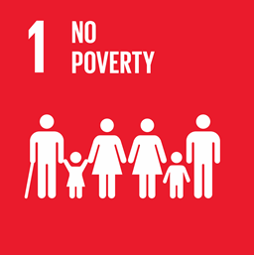
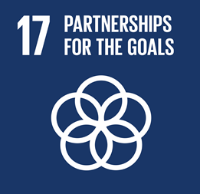
CHANGING LIVES THROUGH EDUCATION
A fundamental human right for everyone
A powerful driver for sustainable development and peace
One of the strongest instruments for reducing the multiple barriers
Makes it possible for women and girls to stand out as equals
An understanding of the world around us
Opportunity to use that knowledge wisely
UDHR Article 26 - Everyone has a right to Education

Slide 7
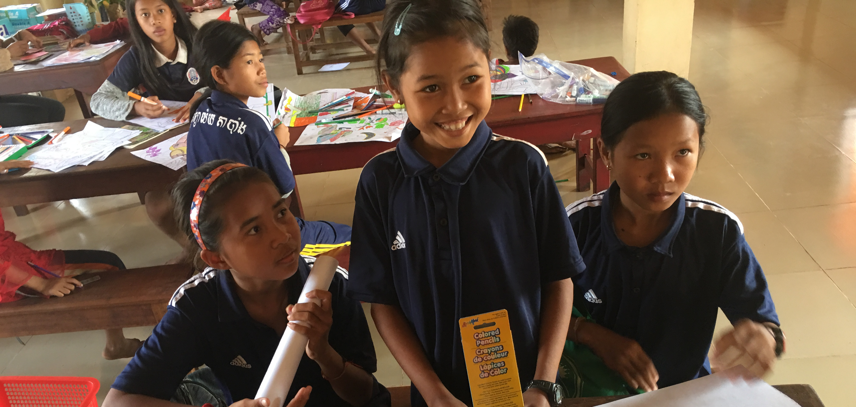
OBJECTIVES
To provide access to education in all its forms for disadvantaged and marginalised women and girls
To provide education or women and girls in a safe, friendly and stimulating environment where there is equality of opportunity and support for all
To develop self- confidence, self-esteem and to feel valued through mentoring programmes
To enable women, particularly the most vulnerable and excluded in society to access information, resources and service they need to make positive life choices
To break down barriers to learning and participation for women so that they become fully active citizens and are equipped to pass on their experience to benefit their families and broader communities

Slide 8
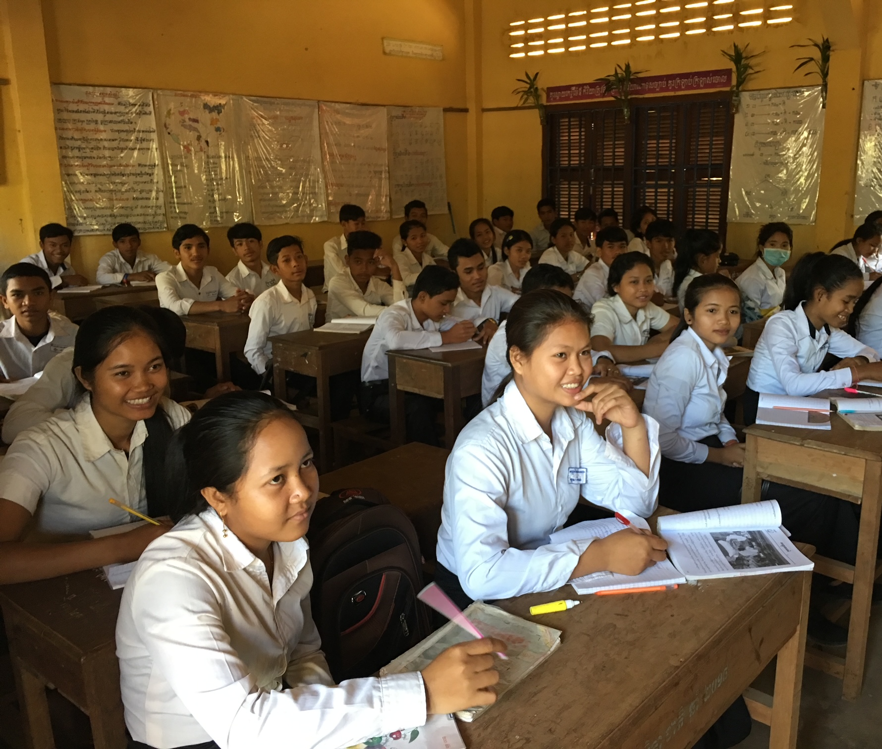
MEANS OF IMPLEMENTATION
Effective Learning Environments
Scholarship
Teachers and Educators

Slide 9
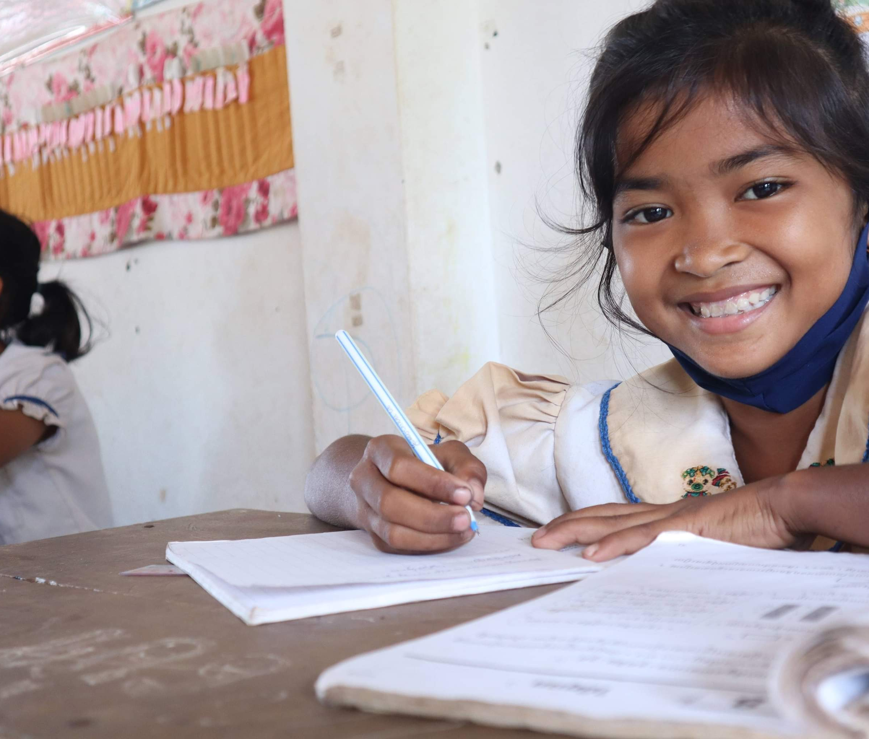
OUTCOMES & IMPACT
Women and Girls Will:
Learn and feel safe
Opportunity to complete differing levels of education
Acquire the knowledge and skills to compete in the labour market – earn higher incomes
Learn socio-emotional and life skills
Make decisions about their own lives - be able to marry at a later age
Contribute to their communities and the wider world

Slide 10
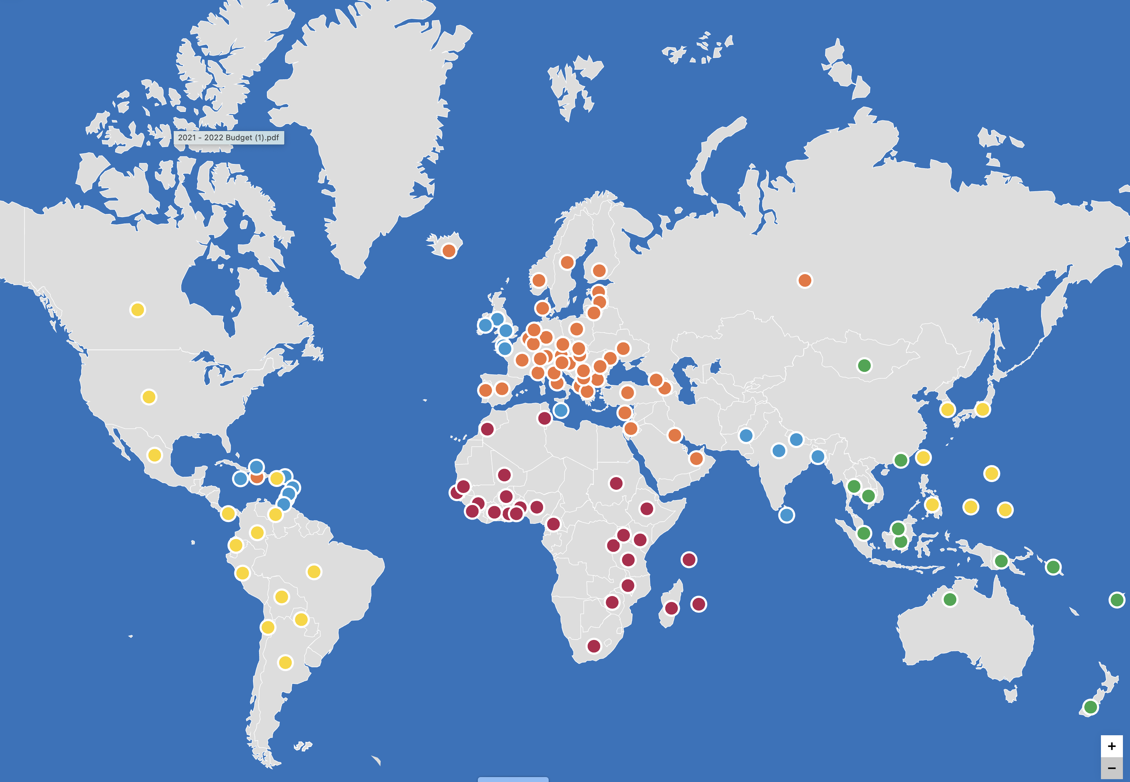
Opening Doors to a Bright Future will implement one project in each of the five Soroptimist Federations
SIGBI: Pakistan
SIE: To Be Decided
SISWP: 1st Project will
launch in Cambodia
SIA: To Be Decided
SIA
SIAF: Uganda

Slide 11
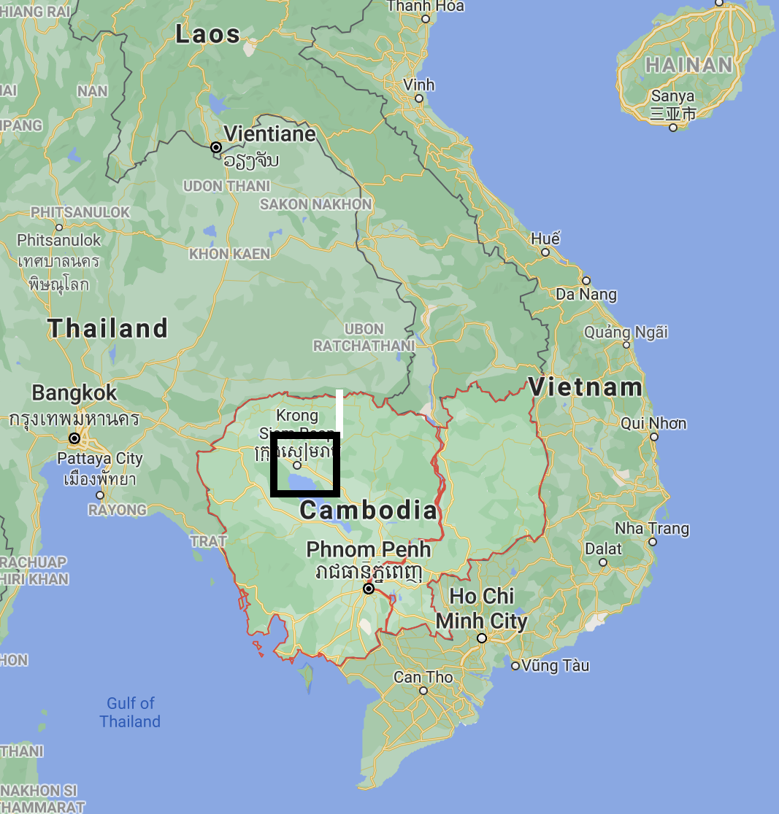
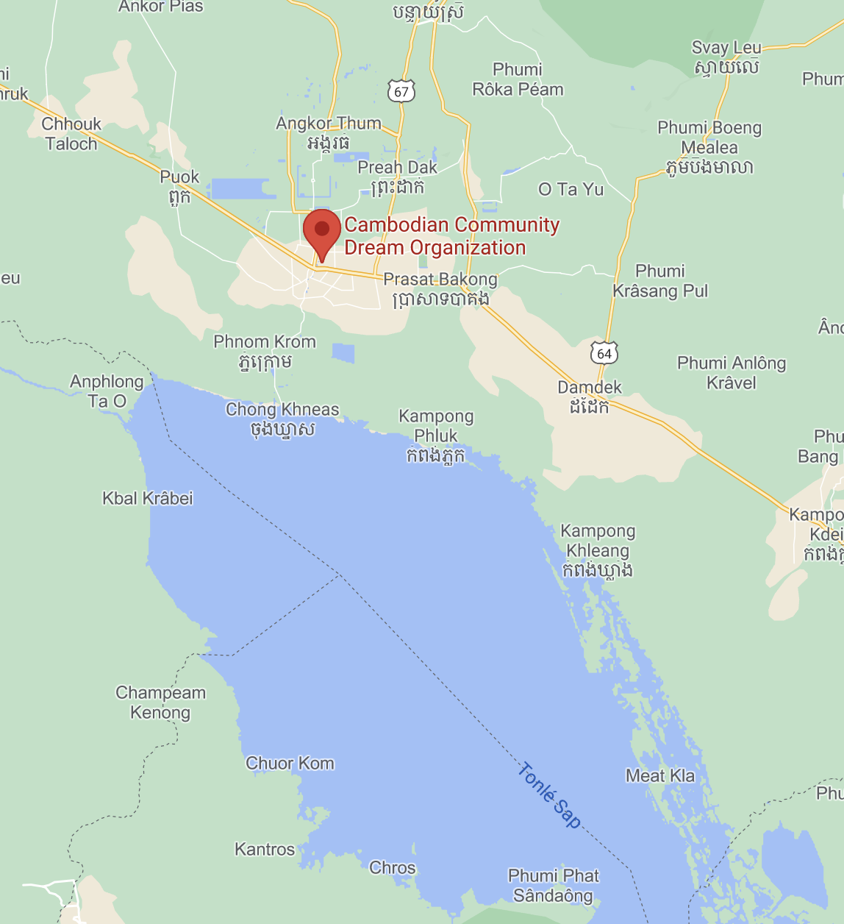
Education and Learning in Cambodia throughout the life course
Cambodian Community Dream Organization (CCDO) in Siem Reap District Cambodia

Slide 12
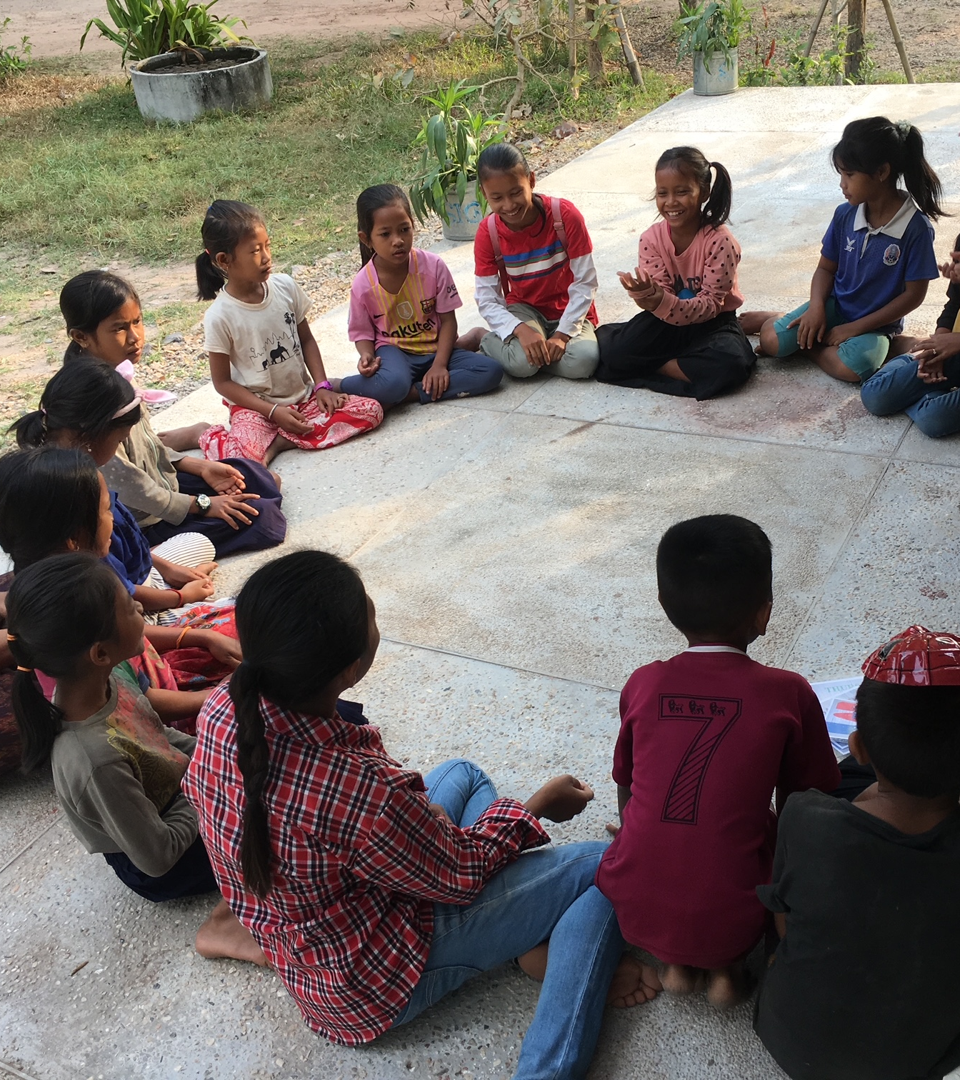
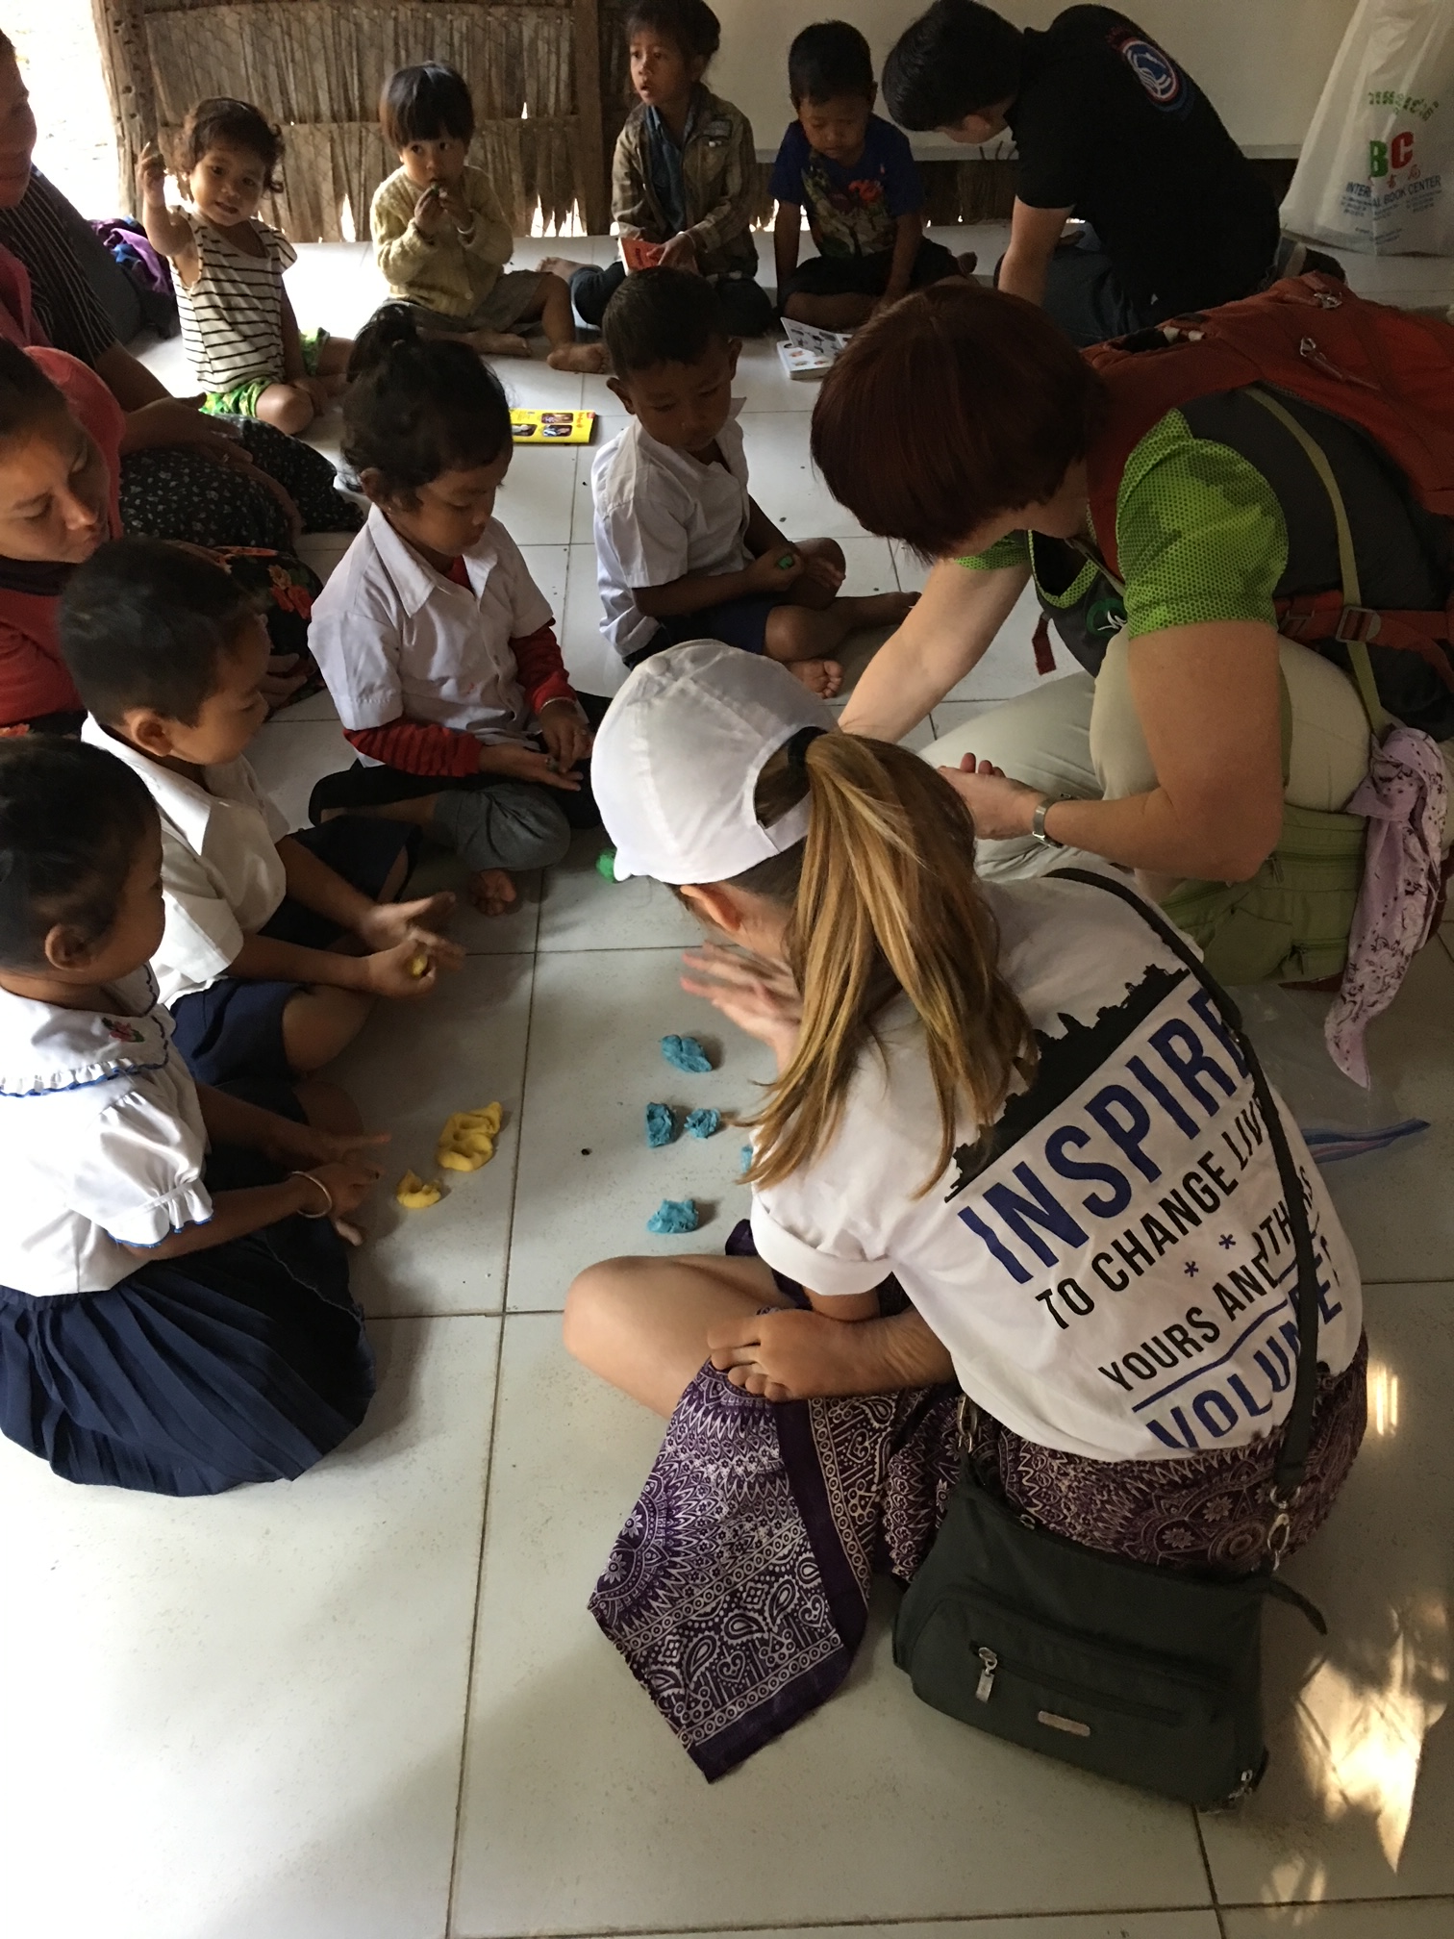
Enabling girls to return to education

Slide 13
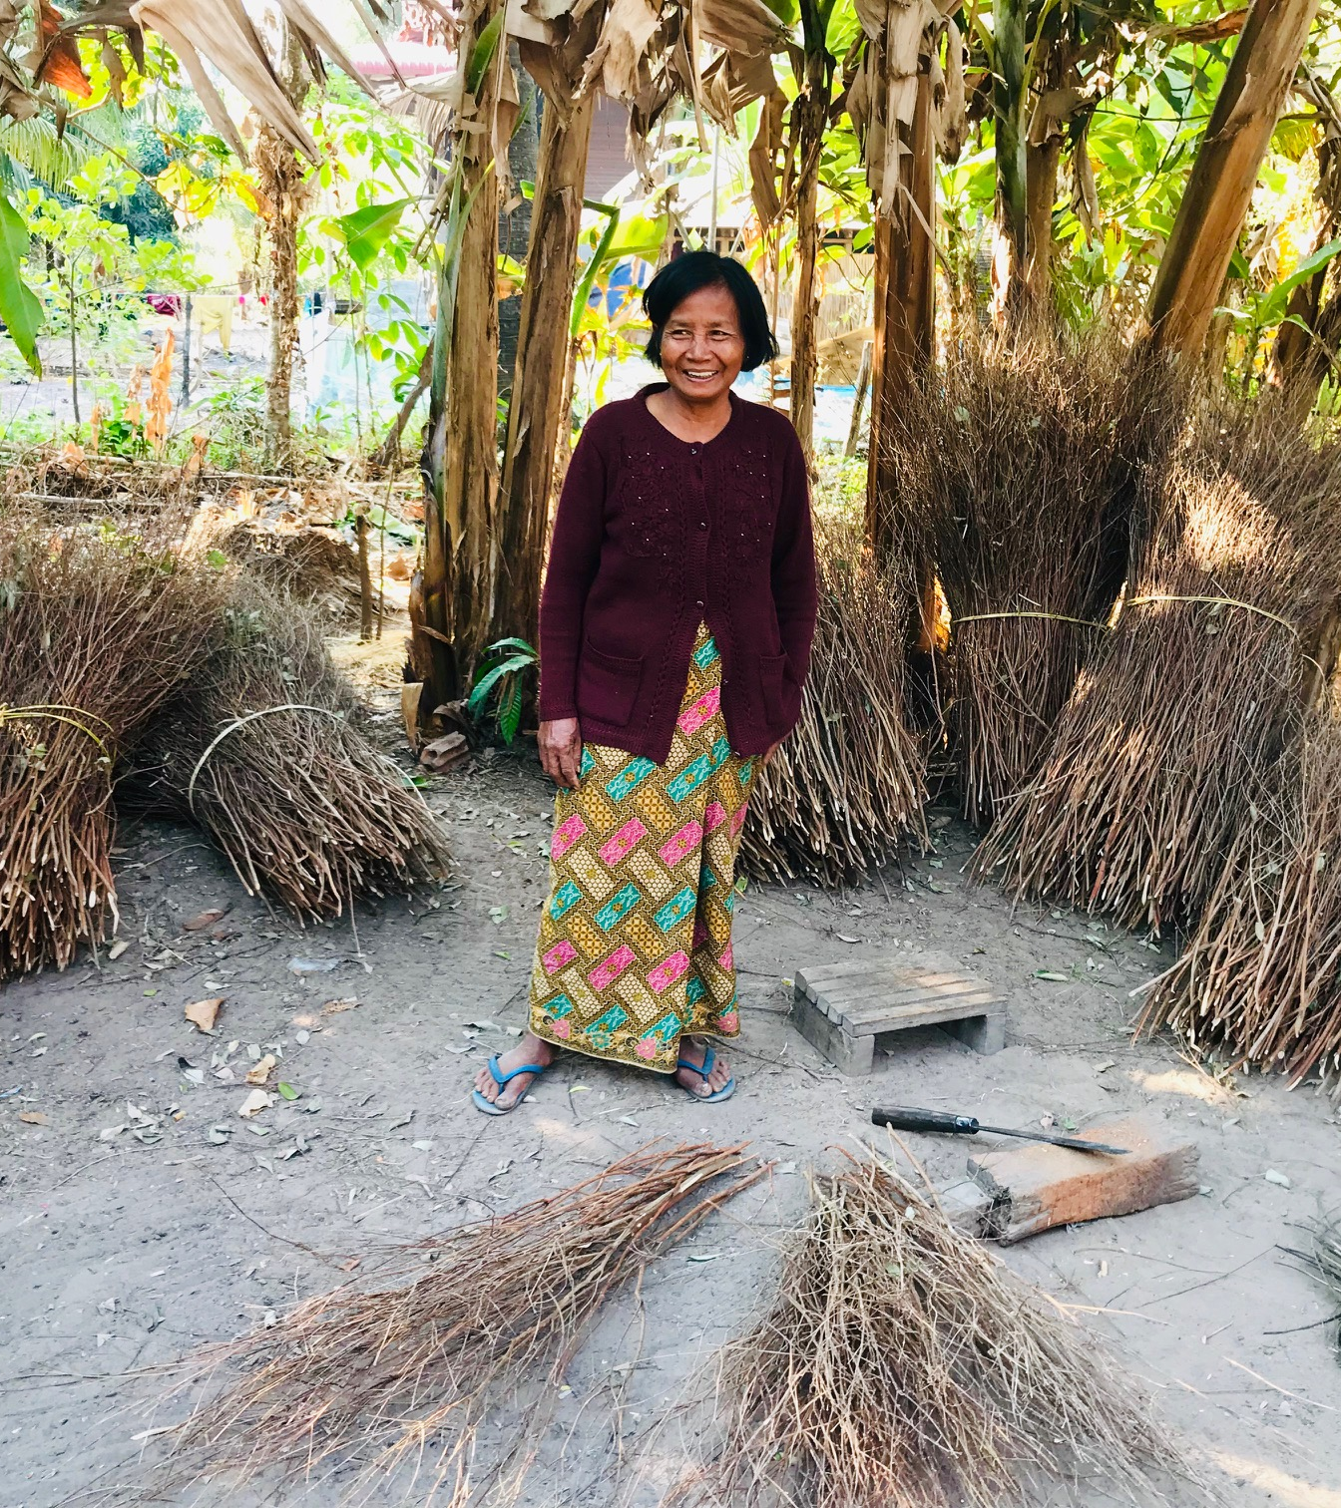
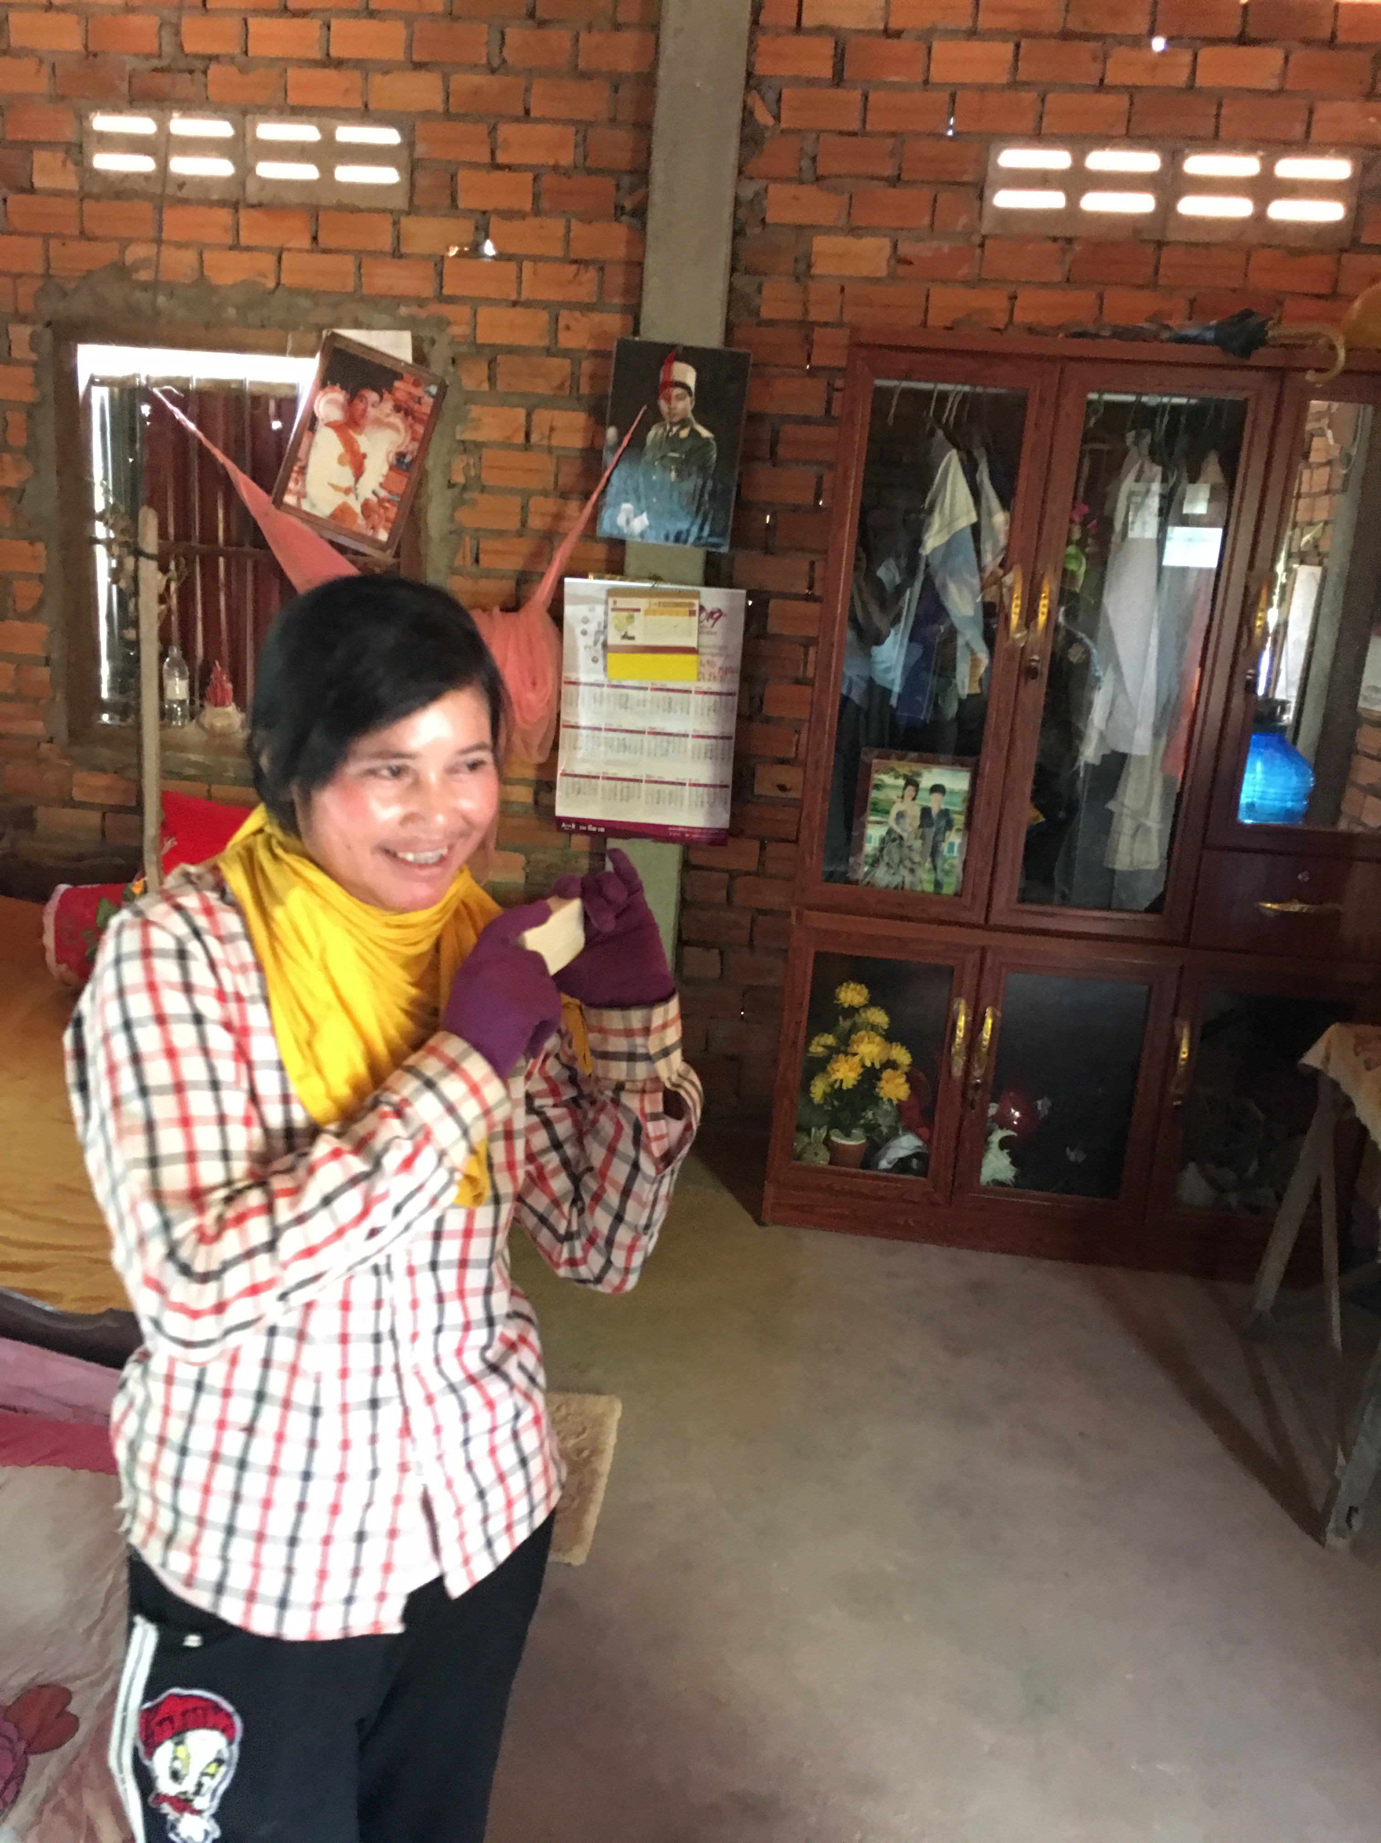
Improving self confidence & self esteem, becoming financially independent

Slide 14
Soroptimist International Foundation (registered in England and Wales 1194895

