Slide 2
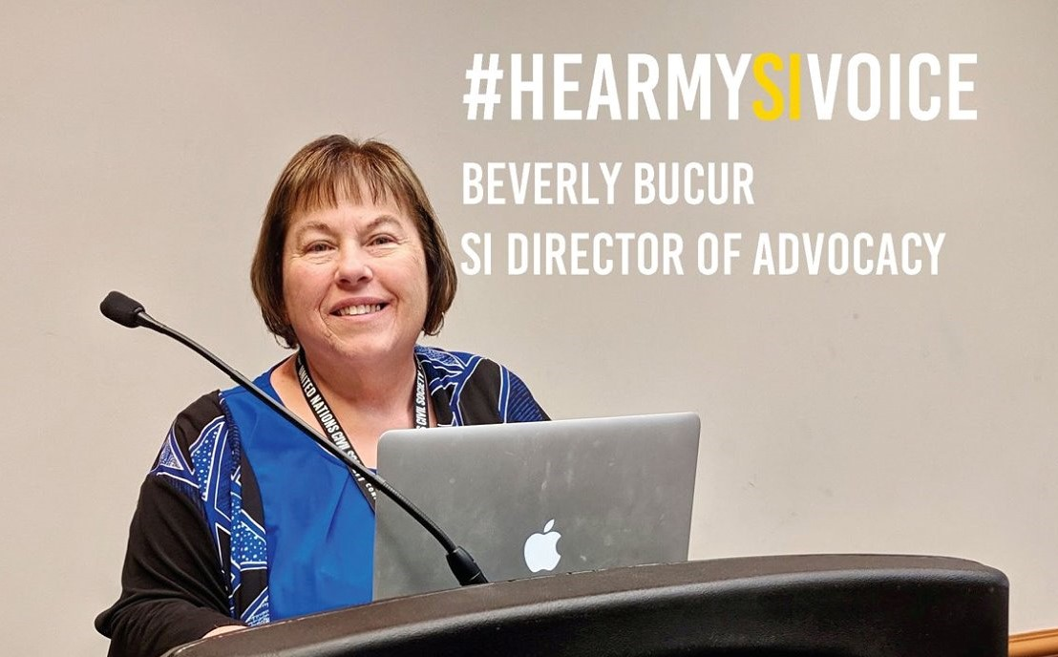

Slide 3
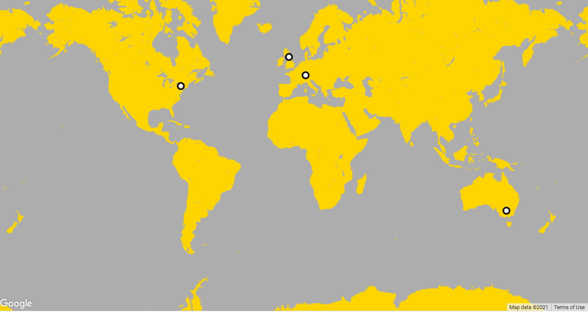
A global volunteer movement, Soroptimist International works to transform the lives of women and girls through a network of over 72,000 club members in 121 countries and territories worldwide.

Slide 4
Soroptimist International Consists of Five Federations:
Soroptimist International of Africa
Soroptimist International of the Americas
Soroptimist International of Europe
Soroptimist International of Great Britain and Ireland
Soroptimist International of the Southwest Pacific

Slide 5
Ulla Madsen
Assistant Director of Advocacy
Soroptimist International

Slide 6
“Women belong in all places where decisions are being made. It shouldn’t be that women are the exception.”
Ruth Bader Ginsburg
Presenters:
Ulla Elizabeth Madsen – Moderator
Sharon Fisher – SI President
Beverly Bucur – SI Director of Advocacy
Claire Gilman – SI Youth Advocate
Penny Babb – SI of the Americas
Chinwe Ezenwa Mbah - SI Federation of Africa
Saija Kuusisto-Lancaster – SI of Europe
Irmin McKenzie – SI of Great Britain & Ireland
Diane Lockwood – SI of the South West Pacific

Slide 7
Claire Gilman
Soroptimist International Youth Advocate

Slide 8
Soroptimist International Great Britain & Ireland
Presenter: Irmin McKenzie
DIGIGIRLZ (TRINIDAD & TOBAGO) 2020

Slide 9
DIGIGIRLZ (Trinidad &Tobago) 2020
A Science, Technology, Engineering and Mathematics (STEM) Project
A VIRTUAL PROGRAMME ACTION PROJECT
In Collaboration with Microsoft (Trinidad & Tobago) & Microsoft (UK)

Slide 10
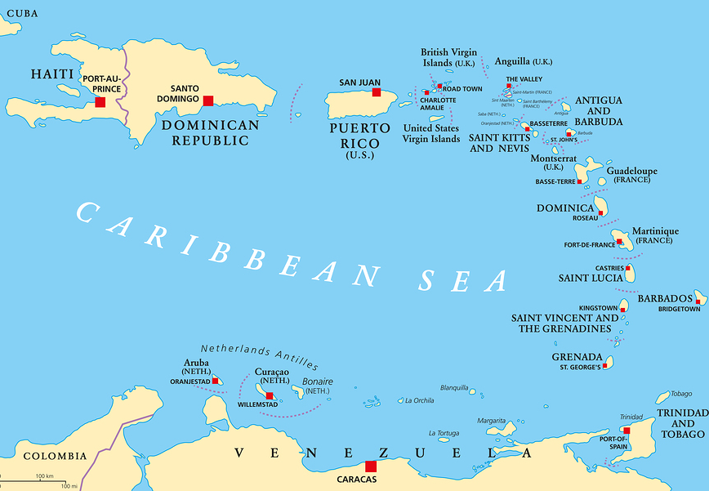
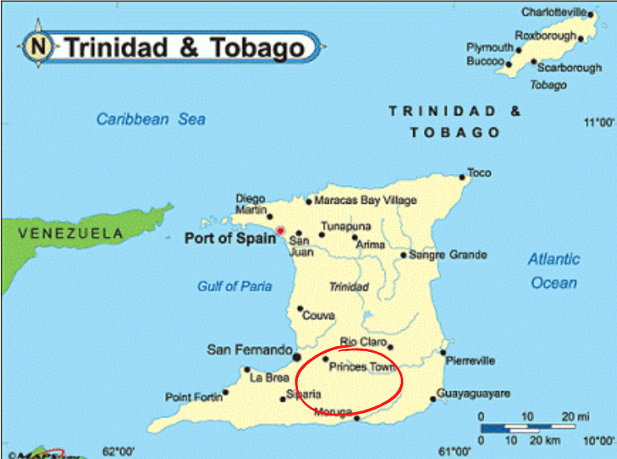
WHERE WE OPERATE

Slide 11
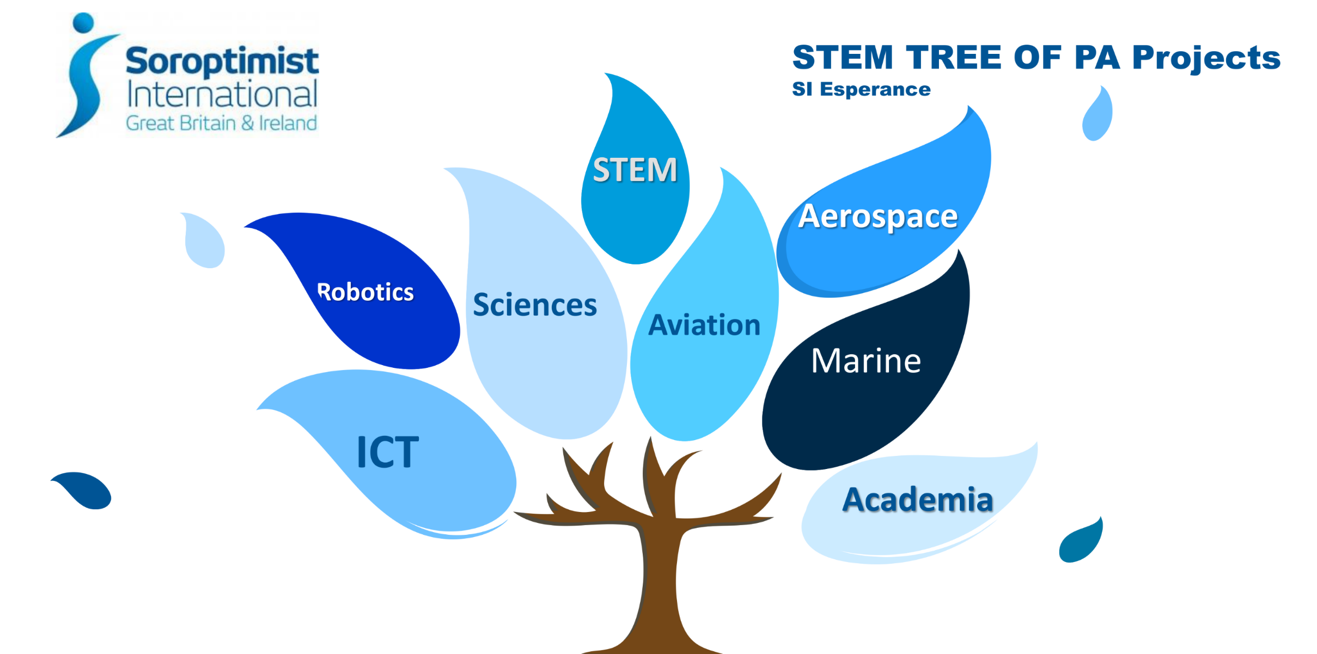

Slide 13
A collaboration between Microsoft Trinidad, Microsoft UK and SI Esperance
The first Virtual DigiGirlz in the Americas in 2020
Connected 40 participants - 28 students, 7 teachers and 5 presenters from 3 different countries, in 3 different time zones
Presentations - "7 ½” things to know about Artificial Intelligence (AI); Webpage Development; Gaming; Personal Branding on Linked-In
Notes:
After weeks of planning, DigiGirlz Trinidad & Tobago – a collaboration between Microsoft (Trinidad) Microsoft(UK) and Soroptimist International Esperance,

Slide 14
WHAT MADE THIS SPECIAL
STUDENT FEEDBACK
First Virtual DigiGirlz in the Americas
In spite of the pandemic, we connected with our community. #SoroptimistsConnect
28 girls from rural schools were made aware of non-traditional STEM careers and non-traditional routes into them
Links were provided to online resources
“Each presentation is better than the last”
“It’s an eye-opening experience in different ways that I can do stuff that I like and still make money”
“Web Development is something I can see myself doing in the future”
“I loved it Miss. It was very educational and opened my mind up to different things.”

Slide 15
THANK YOU

Slide 16
Notes:
Front holding slide

Slide 17
THE STORY OF AFRICAN GIRLS ON THE WAY TO SUCCESS
The girl child in Africa is an endangered species in many spheres, so also are their growth in life. They are endangered from the Cultural and Traditional practices, poverty, stereotype, education, inequality etc, so when an opportunity calls, many of them are ready and willing to run with it. Hence the success story you will hear from few selected projects by Soroptimists in Africa from Morocco in the North to Nigeria in the West and Zimbabwe in the South, as they try to give meaning to life in different ways..
Overall, it is expected that the programs organized for the girls will help them address stereotypes, overcome gender discrimination, learn confidently and develop capacity to lead within the space offered by the governance system
Notes:
Text / image slide

Slide 18
THE STORY OF HAFSA
"I've always dreamed of a great career as a General Manager within the hospitality industry. That's something I can only achieve through opportunity, hard work and passion. At SHBM, this passion was rekindled. This is thanks to the opportunity given to me by the kind hearts at SHBM and the learning by doing principles, the passionate, motivated, and highly experienced instructors, who inject both passion and professionalism into all the knowledge they impart on us. ‌I knew it, SHBM was the opportunity that came knocking and I am grateful being chosen. I am excited to experience and learn more with each passing day, and confident in the great future that awaits me as a SHBM laureate." HAFSA/Bachelor’s degree student @ SHBM #shbmstudents #hospitality #shbmconnect
Notes:
Text / image slide

Slide 19
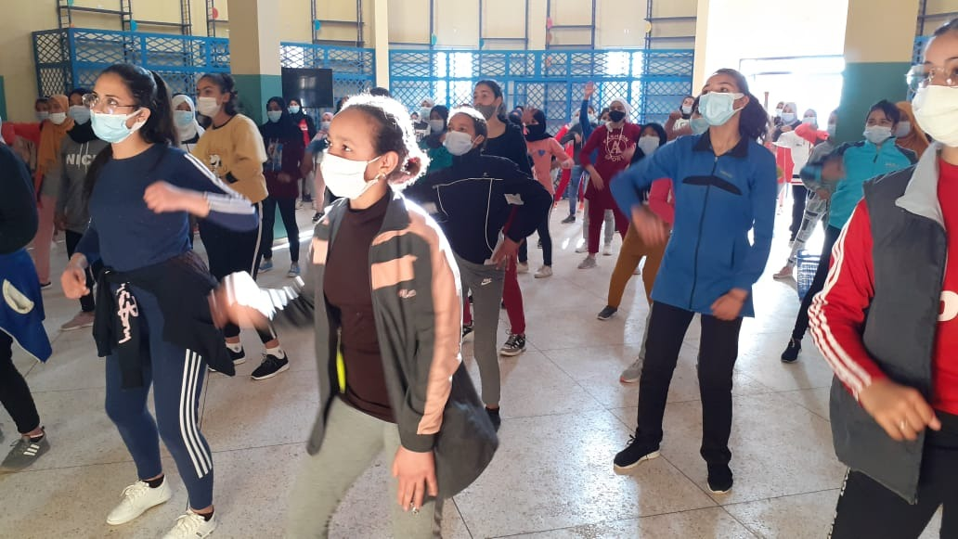
THIS PROGRAM IS UNIQUE AS IT COVERS SDG 1,2, 4, AND 8
Typical prep at the hostel and the girls learning a dancing class to ease tension and relaxation
Other girls that came from the remote villages and are housed at SHBM
Notes:
Text / image slide

Slide 20
SI LEKKI, LAGOS NIGERIA IN PARTNERSHIP WITH THREE OTHER FOUNDATIONS DOMESTICATE THE PRIORITY THEME OF THE UNCSW65 IN NIGERIA. SDGS COVERED ARE POVERTY, QUALITY EDUCATION
Distribution of sanitary pads to over 201 girls in public schools. The intent of this is to help them overcome the violence associated with bullying during menstruation
The Programme also offered a platform for the girls to develop self esteem and establish leadership qualities.
Notes:
Text / image slide

Slide 21
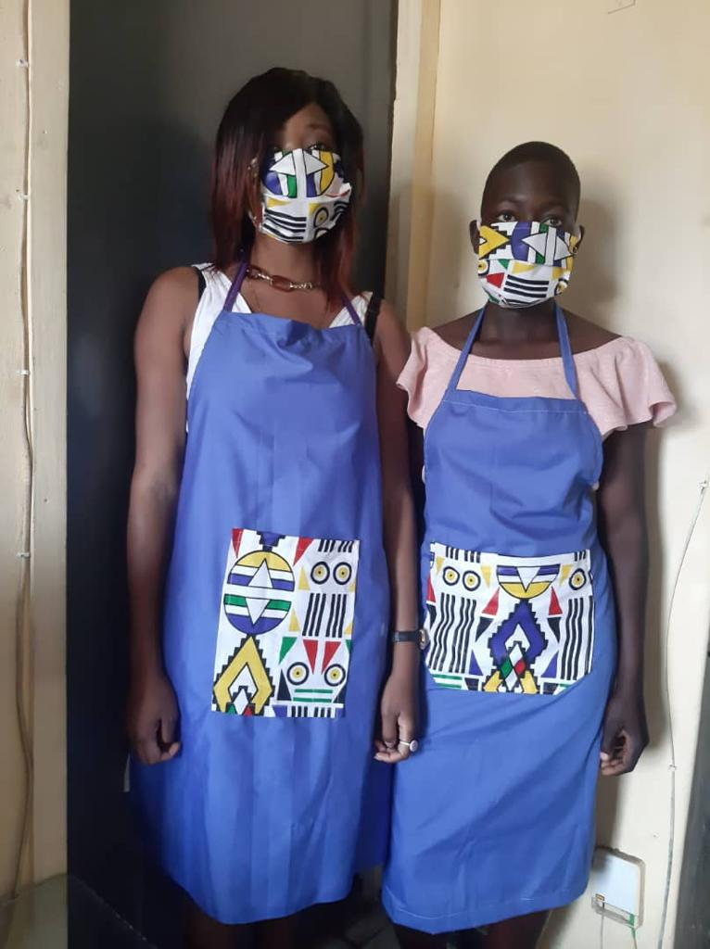
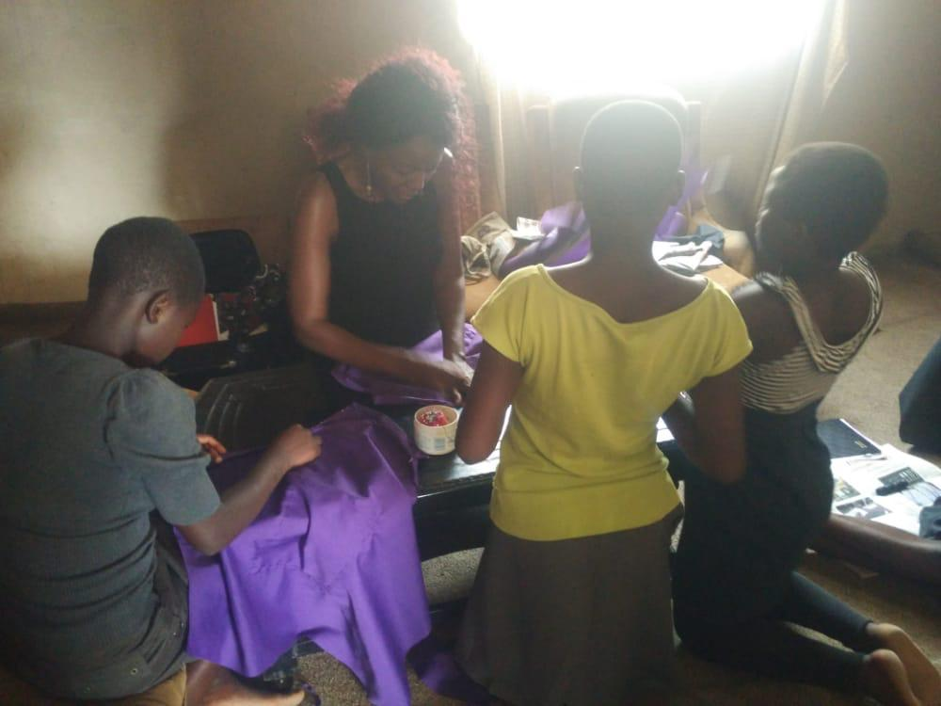
SI. Harare club in Zimbabwe supports Rusike Orphanage in Epworth a high-density suburb in Harare. We have been working with this orphanage for two years. The orphanage looks after girls. The girls are equipped and empowered through skills training programs that focus on different areas of life. As shown in the pictures below, last year the girls were trained on how to make aprons and masks through a skills development social enterprise called Chengetedza. The orphanage has embraced this sewing project and are now earning an income through selling these masks in this COVID-19 pandemic to the community they live in. This covers SDG 8 and 9 The girls showcasing their work.
Notes:
Text / image slide

Slide 22
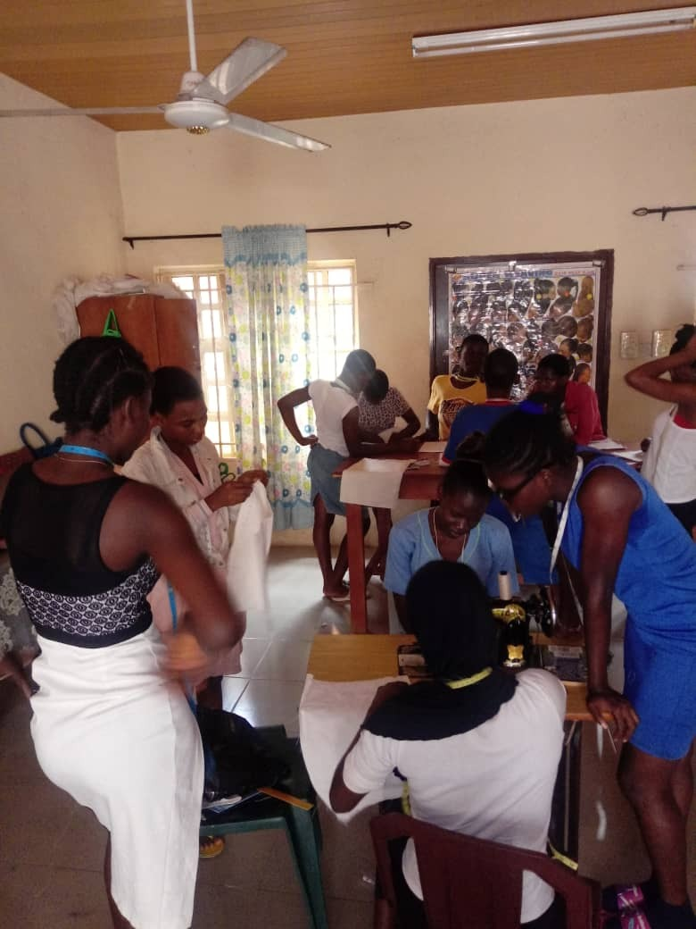
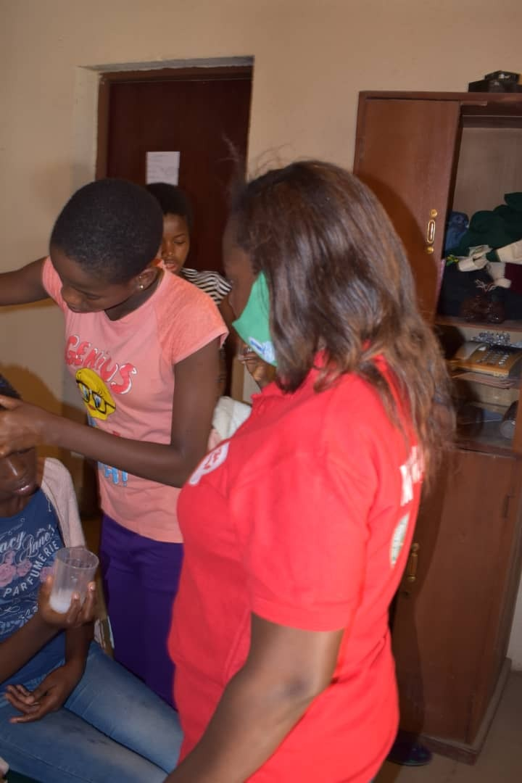
Skill acquisition and entrepreneurship programme for girls in this transit camp. These are girls who ran away from home or were deceived into greener pastures. This project is unique under SDG 1, 2 and 8.
Notes:
Text / image slide

Slide 23
Notes:
Back holding slide

Slide 24
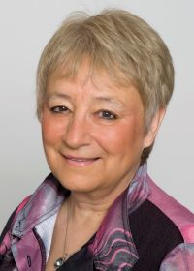
Soroptimist International
Preparing Women and Girls to Lead

Slide 25
From “Local to Global” to ensure the voices of women & girls are heard. Advocating for human rights and gender equality is at the heart of our work.

Slide 26
Maternal Health
Solar Lighting & Cooking
Disaster Recovery – Nepal
Water & Climate Leadership

Slide 27
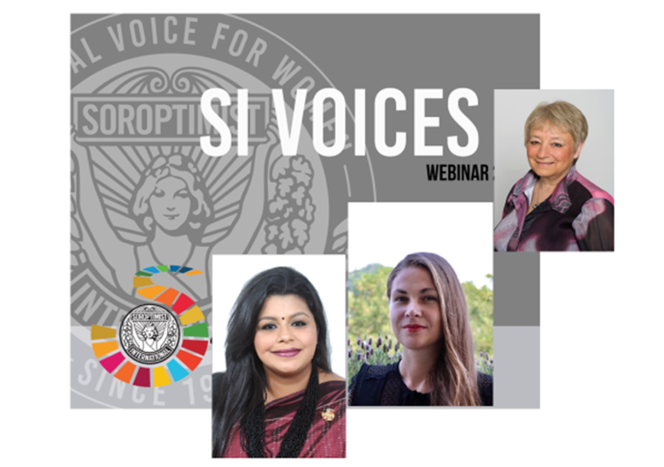
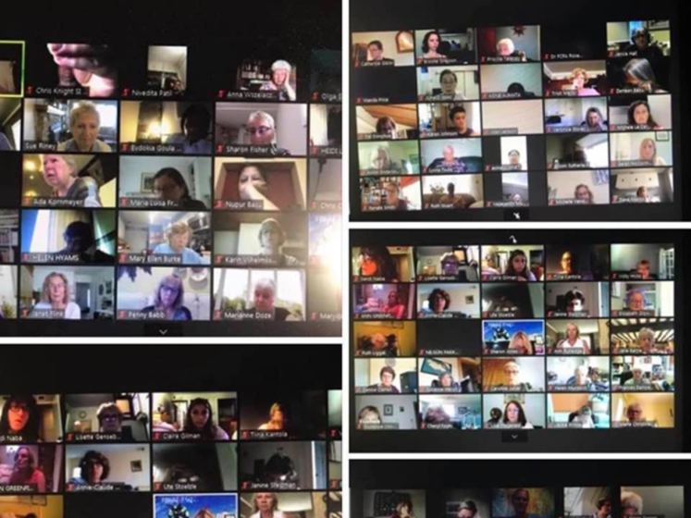

Slide 29
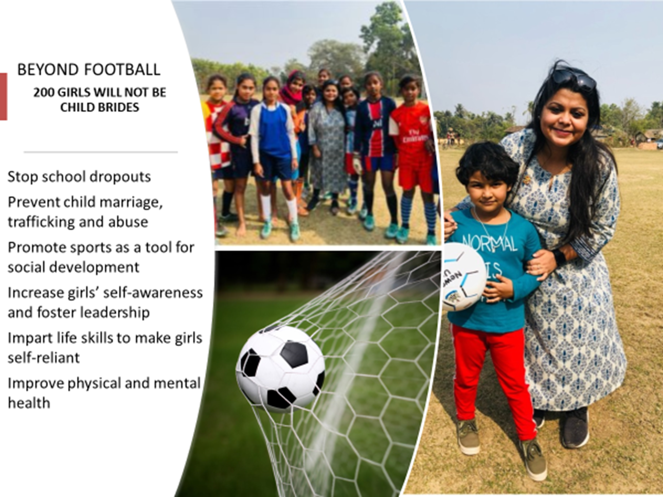

Slide 30
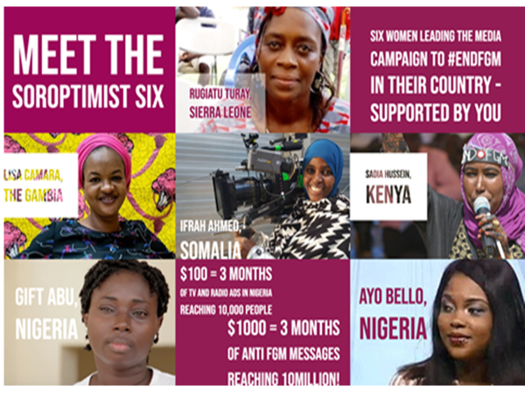

Slide 31
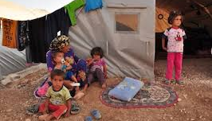
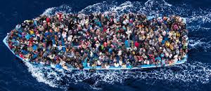

Slide 32
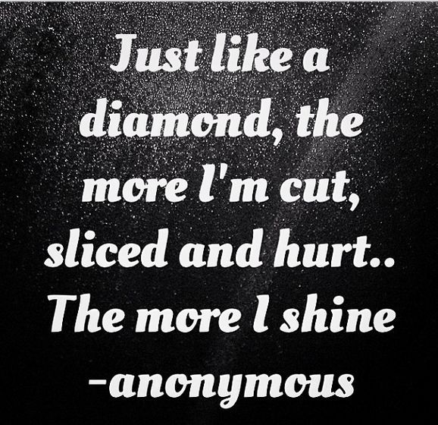

Slide 33
