Slide 1
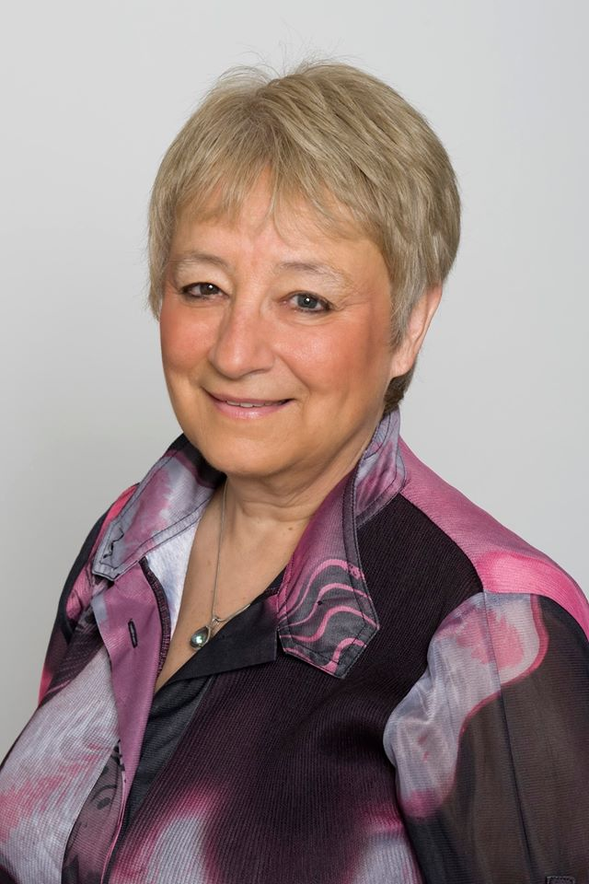

Sharon Fisher, President
Soroptimist International
Notes:
Welcome everyone, I am Sharon Fisher, current President of Soroptimist International.

Slide 2
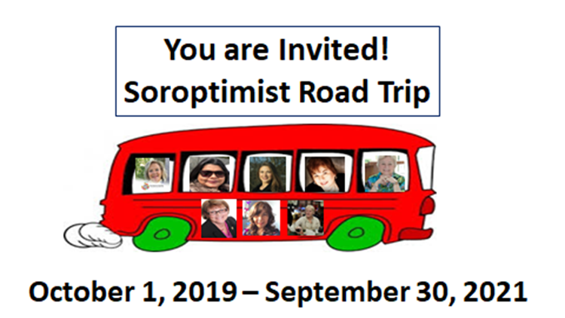
Exploring the Road to Equality
Soroptimist International
August 20, 2020
Notes:
The topic of today’s webinar is “Exploring the Road to Equality”, the subject of the Presidents Appeal for 2019-2021. In KL I invited members to get on the virtual bus and go on a journey to understand the UN slogan “Leave no one behind” knowing that women and girls were at risk. As Soroptimists we work tirelessly for education, but there are many who cannot start or complete their education so are left behind and may never reach their potential. If there was no violence against women and girls, if there were no harmful traditional practices, would that be a world of gender equality. So what would it take to make that happen? Well of course starting at the top where most countries of the world are at the table at the UN trying to agree on global policy and SI is working with many like-minded organizations to influence global policy that does not move the needle on the change we need. Instead that happens when people work together locally, regionally and nationally. We need to influence our own governments/member states to make a stand on issues. To do that our members would need to understand the issues, understand the position of their own government on these issues, and work from the bottom up to create the conversations and collaborate with others to bring these stories that will gain attention and provide the evidence and advocate for change in their own countries.

Slide 3
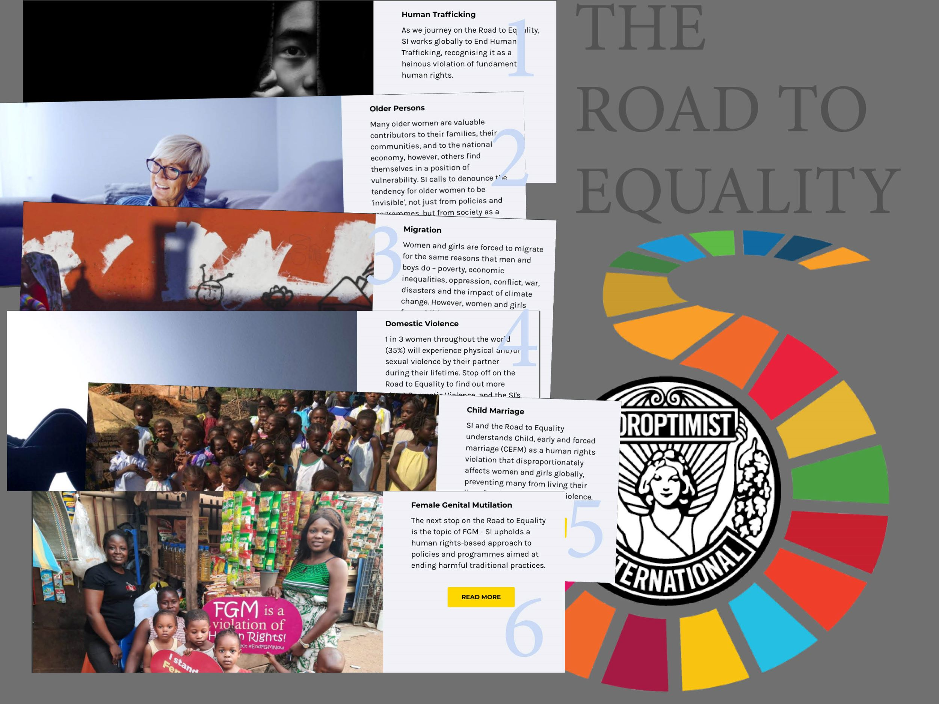
Notes:
During my time as a Soroptimist I have heard so many stories that I could not believe but also stories of resilience, stories of success,…..The topics I chose to share in this appeal all are issues that have triggered emotion, are very real and negatively impact women and girls globally. I wanted all of you to become “experts” in the conversation. My experience was that when I brought any of these topics up in a conversation some did not believe these things happen, some did not want to talk about them, many think they only happen someplace else and many felt it was someone else’s problem to deal with. And so the first step was to encourage our members to understand. With our bus as a traveling classroom, we could learn together! This could be done through project outcomes, forums and seminars.

Slide 4



STAY HOME
Notes:
We no sooner began of course when COVID 19 paid us a visit. We had launched one project and one forum and had several others ready to begin and the world went into lockdown. Traditional on the ground projects were being postponed. Most were occupied by Covid 19 work and clubs/members around the world were at home and not meeting or fundraising. And so began my presidency of SI! As we settled into a “new normal” as it was becoming known which I didn’t see much normal at all, Soroptimist began to show their resilience. After cleaning out cupboards and drawers, baking until all the yeast had been used up, gardening obsessively, getting all those small repairs and reno’s done at home, I think we all realized this was not going away anytime soon.

Slide 5


We are all in the same storm,
But we are not all in the same boat
Notes:
My moment was in reading the slogan “We’re all in this storm together, but we are not all in the same boat”. The secretary general has refined the statement recently in adding something about the stormy seas and some of us are in super yachts while others are barely clinging to floating debris.

Slide 6
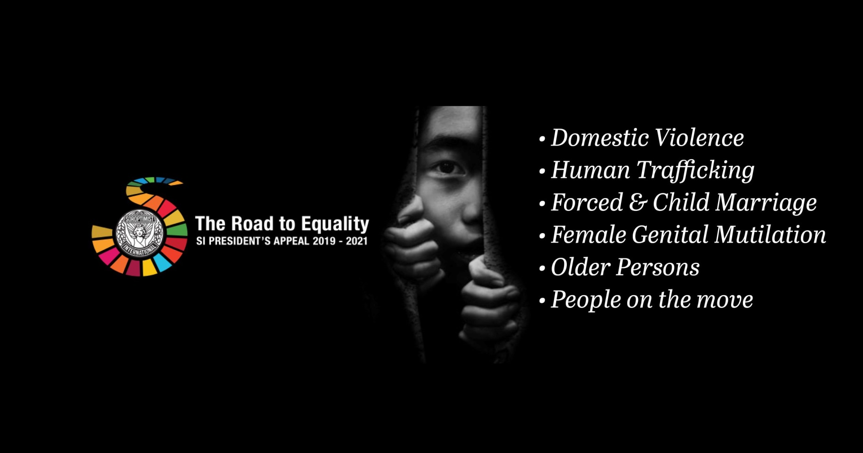
Notes:
How true this statement is and of course we then started seeing the quoted statistics about the increase in violence against women, the increase in FGM with girls being out of school, the increase in Child Marriage, the increase in Trafficking, the increase in Migration and of course the rights of older women have shocked us greatly. These were our topics and we pivoted this appeal to shine a light on those issues in the context of COVID 19.

Slide 7
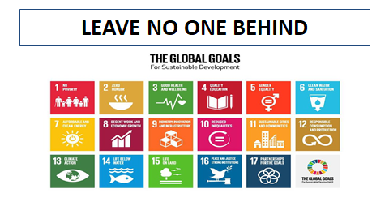
Notes:
The other noteworthy point was that working on these issues during a pandemic was the best way to bring news to these vulnerable populations and those we were working with were doing just that. So today our 2 appeal coordinators will highlight the issues and future webinars will take a deeper dive into these issues and then we will introduce our guest speaker.

Slide 8
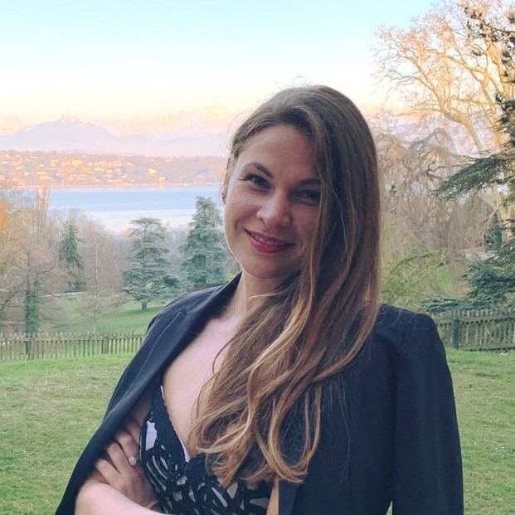
Olga Sidenko
President’s Appeal
Co-ordinator
Notes:
I would now like to introduce Olga Sidenko who is one half of the President’s Appeal team. Olga lives in Switzerland and her work has given her insight into refugees and asylum seekers and how women and girls are impacted in that world.

Slide 9
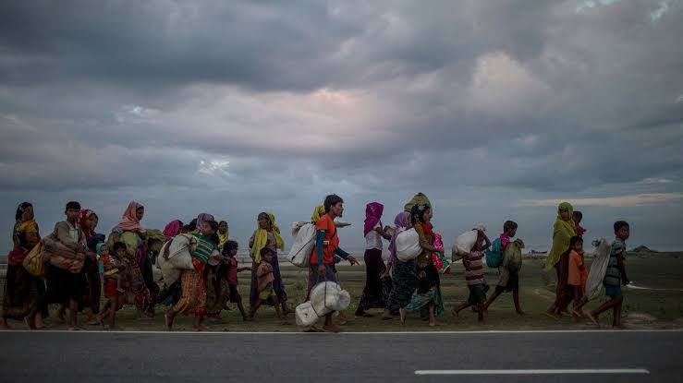
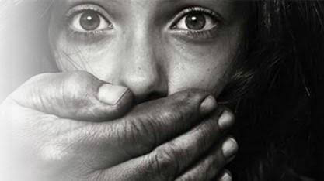
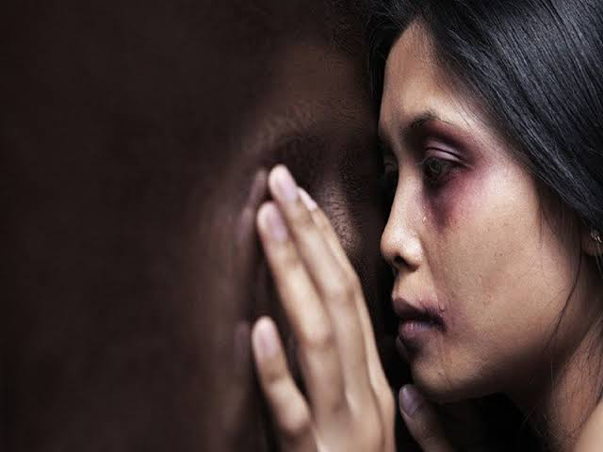
MIGRATION
HUMAN TRAFFICKING
VIOLENCE
Notes:
Road to equality - it’s not only about equality. It’s about all the issues that women are facing in the different parts of the world, in the different dimensions of the society, culture and political orders. Migration, Human Trafficking and Violence are the most widespread issues which are also very connected.
When we talk about migration, we imagine people who leave their homes escaping from war, poorness or repressions. They are searching for the better life for themselves and their children.
Unfortunately, women and girls are the most vulnerable category of migrants and they go through the terrible conditions to reach their goals. Sexual slavery, diseases, death of their children on the way, violence and raping in the camps - it’s all what migrant women confront with during their journey to their destination. However human traffickers are usually the only ones who can provide them with the necessary support crossing the borders, but it’s always a risk to become their victims of the sexual abuse and violence.
And even if a migrant woman has survived on the way and has reached the destination, she can’t just enjoy her life. It’s very difficult to find a job in the foreign country, without necessary language and skills. She can’t integrate in the society and usually she has a fear to be sent back where she came from. Migrant women don’t know their rights and they stay as a vulnerable group till the end of their lives.
In our next webinars we will go deeper into these topics talking with the special guests and listening to their stories.

Slide 10
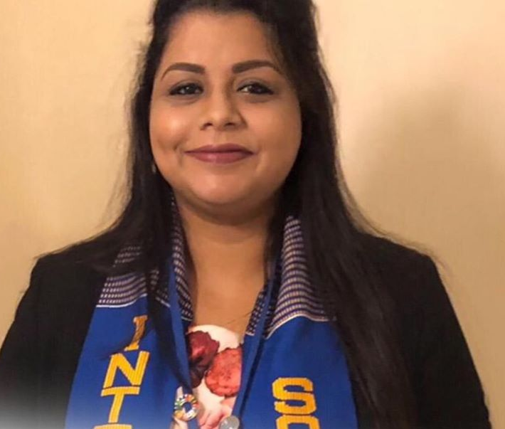
Ayushi Kundu
President’s Appeal
Co-ordinator
Notes:
Next is the other half of our President’s Appeal team, Ayushi Kundu from India who will highlight the other 3 topics of our Road to Equality.

Slide 11

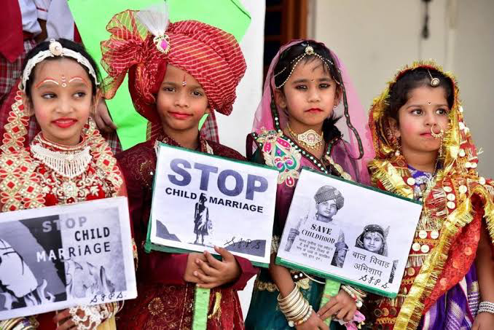
CHILD MARRIAGE
Notes:
Hello Everyone, I am delighted to be speaking to you all today. My Appeal co-coordinator Olga has already spoken to you about some of the areas of our Appeal. I take this opportunity to discuss the three remaining areas with you. Let me begin with this thought: Imagine being married off at the tender age of 10 years. Your husband is perhaps double your age…you don’t even know. All your life, you have aspired to finish your education then become a doctor, so that you can help the people in your community…instead, the morning after your wedding, you are shoved into the kitchen and told that that will be your place henceforth… Rather than spending time with your playmates, you are trying to satisfy the whims and fancies of your husband…and his family.
Imagining ourselves in such situations will be utterly distressful.

Slide 12
Almost 15 million girls are married off before the age of 18 annually. That is one girl in every two seconds.
Child Marriage has several health implications: psychologically as well as physiologically.
Child Marriage is a human rights violation, and hinders educational and career accomplishments.
During the ongoing Covid-19 pandemic, cases of child marriage have reportedly increased due to economic hardships.
Child Marriage snatches away the chances of education and livelihood in girls at a young age, and subjects them to lifelong discrimination.
Child Marriage needs to be controlled to prevent the vicious circle of poverty, violence and abuse, and provide enabling and empowerment opportunities to young girls.
Soroptimist International recognises the importance of this, and has thus included child marriage as a theme of the Road to Equality.
Notes:
Every two seconds, a girl becomes a child bride. Almost 15 million girls each year are forced to sacrifice their dreams, education and rights, by getting married. They end up getting pregnant after marriage, even before they are physically and mentally ready, leading to further health complications. Sadly, during the ongoing Covid-19 pandemic, the instances of child marriage as hit the roof, just like all the other problems on which the SI Road to Equality Appeal is focused. Young girls are being married off by their families for monetary considerations, as families are struggling to survive the economic hardships brought upon them by this pandemic.
Child marriage is an evil which perpetuates gender based inequalities and discriminations throughout a girl’s life.
Data suggests that unless we act right now, an extra 1.2 billion girls will be married off before attaining the legal marriage age, by 2050. Which is just 30 years from now.
At Soroptimist International we understand the urgency to end this harmful practice, child marriage has been included as a theme of the Road to Equality Appeal. We are strongly committed to securing enabling and empowering opportunities for young girls, so that they can lead a fulfilling life.

Slide 13
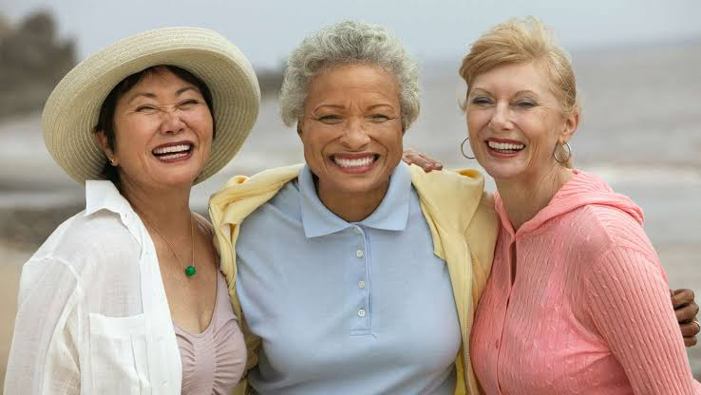
OLDER WOMEN
Notes:
And just as we are concerned about the lives of young girls, we also recognise the importance of securing the interests and rights of women when they reach old age. We believe that the efforts to educate and empower women and girls should not end, or should not become futile, when they reach old age. Thus, older women is one of the themes of the SI Road to Equality President’s Appeal.

Slide 14
Most elderly women spend time in providing uncompensated care-giving activities, which restrict their income and other opportunities.
One of the biggest problems faced by older women today is isolation, which can cause depression, fear and anxiety.
The Covid-19 pandemic has increased loneliness and vulnerability in older women, and has severely affected their social and economic well-being.
Consistently low socio-economic status leads to unequal power status in later life, perpetuating less earnings and savings.
The efforts which are made to induce empowerment in women must not be lost when they reach old age, when they start experiencing discrimination and violence all over again.
It is important to design global policies and practices that will include older women in its agenda, to successfully achieve the 2030 Sustainable Development Goals and equality amongst all human beings.
Realising the urgent need for feminisation of ageing, older women has been included as a theme of the Road to Equality SI President’s Appeal.
Notes:
Throughout a woman’s lifetime, her socioeconomic status is rooted in a division of labor that assumes her primary involvement in society to be in reproductive labour, unpaid household work, and caregiving. This perpetuates unequal power relations in the home and means that women earn less and save less for their elderly years. This leaves them particularly vulnerable to poverty, discrimination, violence, and marginalisation in old age. Having to undertake unpaid care giving activities even at old age further limits their economic and livelihood opportunities.
In addition to these economic inequalities, many political, legal, and health care structures are detrimental to the well-being of older women. Examples include discriminatory inheritance laws, difficulty in making critical health care related decisions, etc.
Under the current climate, the problems faced by older women have been further aggravated: isolation resulting from physical distancing and inadequate digital inclusion, increased risk of contracting the virus due to already underlying health conditions, lack of proper access to jobs, pensions and appropriate health care facilities. The risks faced by older persons have also been recognised by the UN in its recent policy brief: ‘The Impact of Covid-19 on Older Persons’.
As a young woman who recently turned 28 years old, I shudder to think what my life will be like 40 years down the line, unless urgent changes are made to policies and practices. Now is the time when the conversation on older women becomes even more relevant to women of my generation, so that they can eagerly look forward to old age. Through the Road to Equality Appeal, we hope to facilitate deeper understanding and wider awareness on this area.

Slide 15
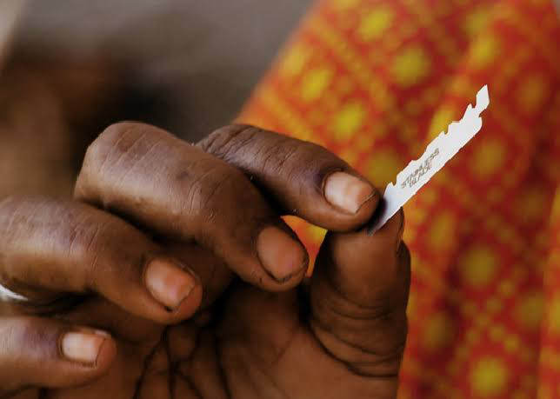
FEMALE GENITAL MUTILATION
Notes:
Female genital mutilation refers to the cutting or circumcision of the whole or part of the female genitalia, mostly done with the view of controlling a girl or woman’s sexuality. It has no recorded health benefit, and can instead cause severe physiological and psychological damage. It may cause excessive bleeding and pain, as also complications during child birth, often resulting in death.

Slide 16
More than 200 million women and girls alive today have undergone FGM across 30 countries in Africa, Middle East and Asia, where the practice is most concentrated.
FGM can cause severe physical health issues such as pain, bleeding (often resulting in death) and complications during child birth, as well as psychological harm.
FGM means circumcision of all or part of the female genitalia for non-medical reasons and has NO recorded health benefits.
Lockdowns during the Covid-19 pandemic has exacerbated cases of FGM, as girls are forced to stay at home and do not have access to law enforcement and health care.
FGM is a traditional harmful practice perpetuated on women on girls, and is a gross violation of human rights, carrying high risks of disability and/or death.
Soroptimist International is committed towards ending this vicious form of violence against women and girls, and protecting their dignity and right to life, and FGM has therefore been chosen as a theme of the Road to Equality .
‘Soroptimist Six’ – the first project under the Road to Equality has been launched in partnership with Global Media Campaign to end FGM.
Notes:
Soroptimist International has adopted a strong stance and expressed its commitment towards ending such traditional harmful practices through its Where We Stand Statements.
Several members in our organisation have undergone or have closely escaped FGM. Inspired by their stories, and driven by the motivation to bring an end to this abhorrent practice which has scant regard for the dignity and right to life of women and girls, FGM has been adopted as a part of the Road to Equality President’s Appeal.
Since FGM is primarily practiced within the precincts of the household, cases of FGM have drastically increased during the pandemic. Closure of schools due to lockdowns, and strict curfew hours have forced girls to stay at home. They are unable to seek assistance from law enforcement and health care.

Slide 17
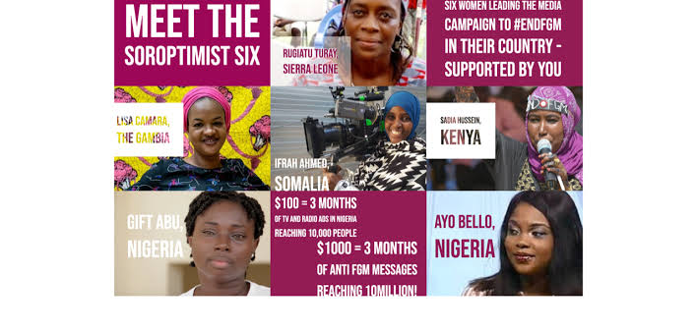
THE SOROPTIMIST SIX
Notes:
The Soroptimist Six activists adopted by Soroptimist International as a part of the Road to Equality Appeal have now focused their attention on preventing cases of FGM from happening during this Covid season, and provide all forms of support to victims or potential victims to escape the horrors of this crime.
Soroptimist International partnered with Global Media Campaign to End FGM in 2019, and launched the Soroptimist Six project. GMC trains and supports activists in Africa, changing norms and mindsets within their own communities to end FGM. 6 activists working with GMC in different African countries where there is a presence of Soroptimist Clubs have been adopted by SI. SI has so far provided a grant of £30,000 to these activists, to continue their anti-FGM campaigns. With these grants, the activists engage with community and religious leaders, as well as members of the larger community, and also use radio and television time and social media to create awareness on FGM and its ill effects.

Slide 18




The Soroptimist Six are focused on bringing an end to the harmful practice of FGM by engaging with high ranking officials in the society and community leaders.
6 activists working for GMC have been adopted by SI, and will be receiving funds from the Road to Equality Appeal fund to carry on their awareness and educational activities.
The activists use television and radio time, as well as social media, to engage with members of the community and increase awareness on the harmful effects of FGM.
During the ongoing Covid-19 pandemic, the activists have used the above forms of media to spread awareness about and curtail instances of FGM. Women in senior ranks in the society have been included in the sensitisation efforts.
Notes:
During International Women’s Day, the Soroptimist Six activists supported 22 TV and Radio broadcasts. These broadcasts reached nearly 38 million people across the different countries where they work, producing 69 hours of broadcast content. Over Easter, the activists funded 28 media campaigns in six countries, producing over 30 broadcast hours for the Emergency Coronavirus Media Campaign, reaching more than 48 million people.
Some specific examples of work done by the Soroptimist Six during the ongoing pandemic are:
Rugiatu Turray, our activist from Sierra Leone, engaged ‘soweis’ or the high ranking women in the Sierra Leone society in the sensitisation programmes to prevent corona. Special posters were designed and used for this purpose.
Sadia Hussein, our activist from Kenya, has launched several hashtag campaigns on Twitter, the most recent one being #EndFGMPreventCorona, to spread awareness about FGM during the pandemic. These hashtags have been trending widely on social media. She has also designed posters with messages which have been widely circulated in markets and shops, has done several radio talk shows with religious leaders and health experts to end FGM and for the prevention of corona, and has recorded videos for mainstream media.
Gift Abu and Ayodeji Bello, our activists from Nigeria, have been promoting campaigns online and through radio and TV, to dissipate information about FGM in light of Covid-19.
We now have a short video to share that highlights some of our Soroptimist Six partners.

