Slide 1
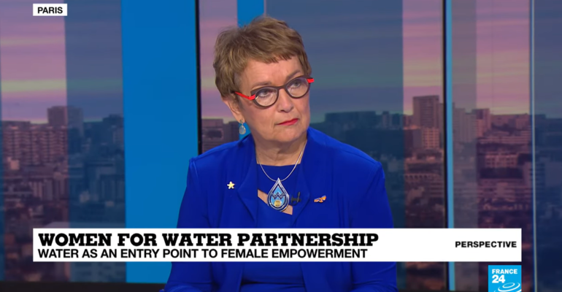
SI President Mariet Verhoef-Cohen
Officer in the Order of Orange-Nassau
@MarietCohen

Slide 2
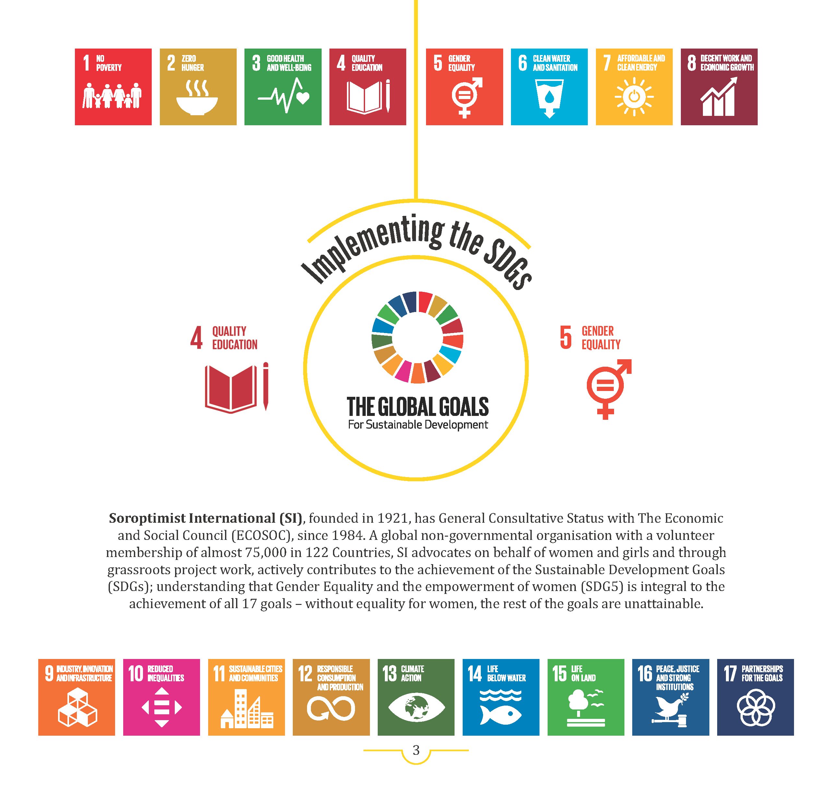

Slide 3
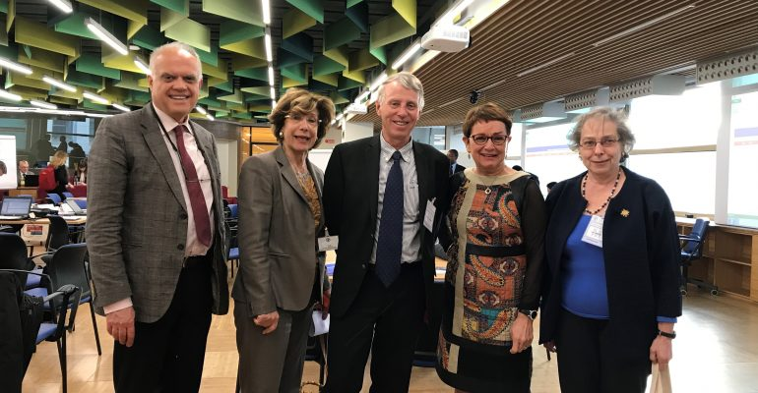
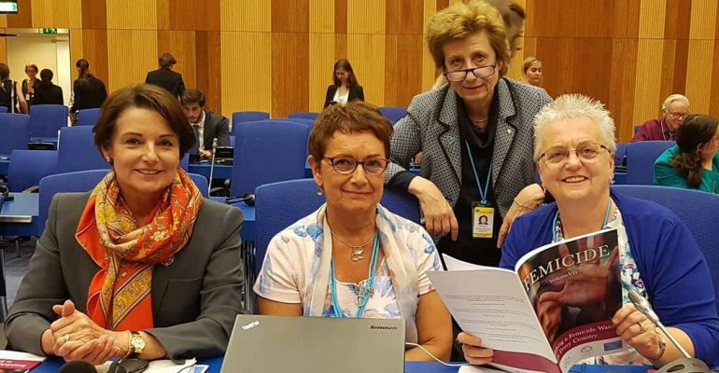
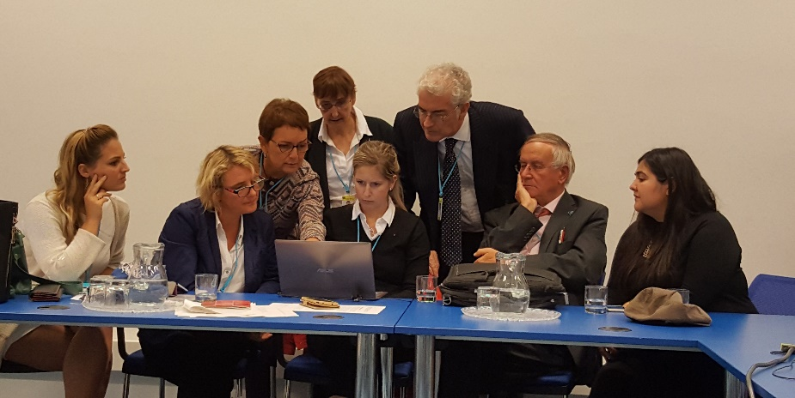
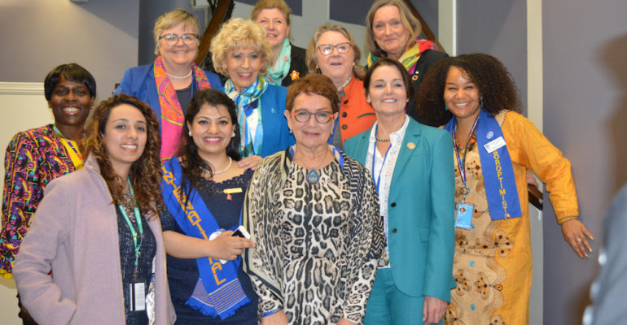
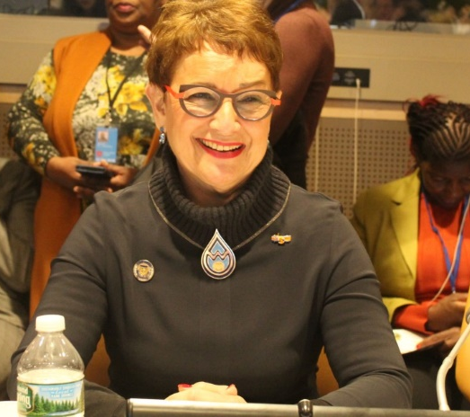
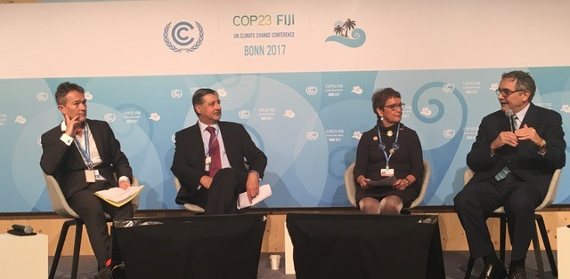

Slide 4
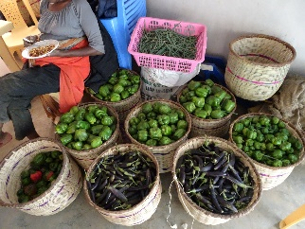
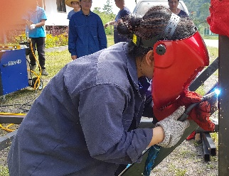
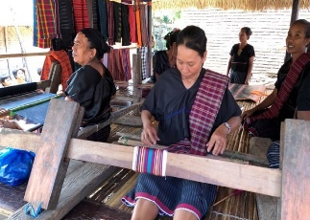
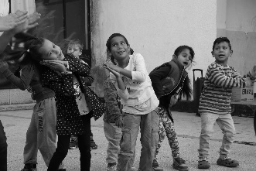
Implementing the SDGs
Women, Water & Leadership
Kenya Mwihoko Women
Increasing Food Security & Water Access through Empowerment & Education for women farmers
Malaysia Clean Water for Rural Communities
Access to Water, Organic Farming & new careers for women & girls
Indonesia Earthquake Recovery
Access to Water, Shelter & Capacity Building
Bulgaria WeWash
Safe Water & Sanitation; Educating women & girls for jobs in water sector

Slide 5
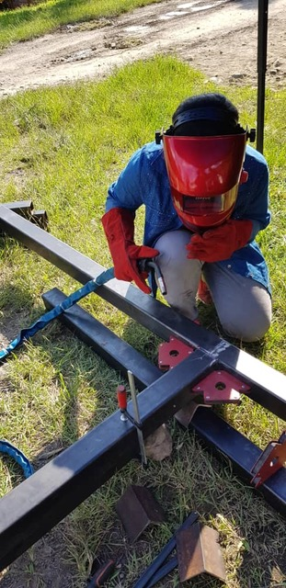
Women, Water & Leadership meets the SDGs SDG 4 |SDG 5 |SDG 6 +
Food & Water Security
Quality Education, Vocational Training, Empowerment & Participation
Sustainable Production & Clean Energy

Slide 6
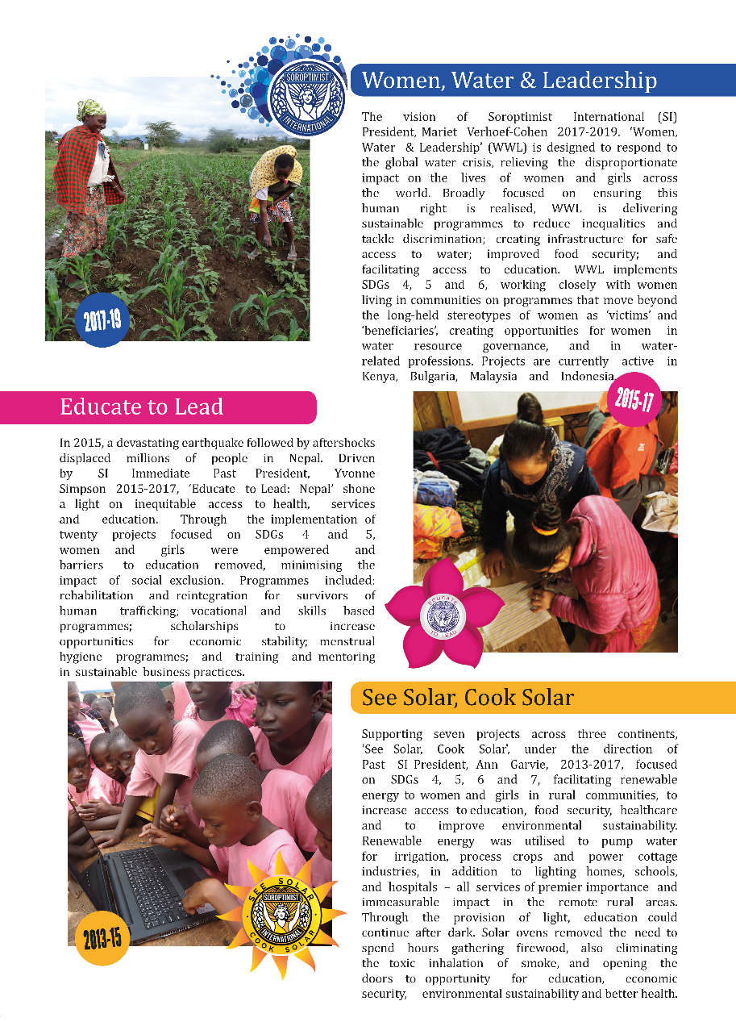
A Global Voice for Women
SI President’s Appeals – Global Visibility

Slide 7
SI President Mariet Verhoef-Cohen
Officer in the Order of Orange-Nassau
@MarietCohen

